Slide 1
PROBING SHORT-RANGE NN CORRELATIONS IN THE REACTION ¹²C+p →¹⁰A+PP+N
Yu.N. UZIKOV (DLNP, JINR)
● Motivation
● ¹²C(p,pd)¹⁰B and pd→dp, pd→{pp}_{s}n at ~1 GeV
● Plane-wave model for p+¹²C→ p+p+N+¹⁰B and
some numerical estimations
● Conclusion

Slide 2
♥ Dubna, 1957, M.G. Mesheryakov et al. ZHETF,
p+¹²C → d+X at 670 MeV; quasi-elastic knock-out of the
fast deuteron clusters
D.I. Blokhintsev (1957) : fluctons (6q) in nuclei
Two nucleons being at short distances r_{NN} <0.5 fm
have a large relative momentum q>1/r_{NN} =0.4 GeV/c;
In addition, a repulsive core in NN-potential → high-moment
in NN pair.
♥ Search for high-momentum components of the nuclear wave
functions of the lightest nuclei – ²H, ³He, ⁴He – in elastic and
inelastic eA-, pA – scattering ( A.Gilman, F.Gross,
J.Phys.G:Nuc.Part.Phys.28 (2002)B13)

Slide 3
♥ A modern trend in this study is investigation of short-range
correlations (SRC) in nuclei – NN-pair in nucleus with almost
zero c.m. momentum but large (equal) internal momenta q₁=-q₂,
q > p_{F} = 250-300 MeV/c.
* High-momentum part (q > p_{F}) accounts for 20% nucleons .
* pn- SRC pairs dominate by factor of 20 as compared to
pp- and nn- due to the tensor forces.
* SRC -connection with neutrino-nucleus interaction, neutron stars
structure, modification of the bound nucleon structure
(EMC effect).
Cioffi degli Atti, Phys. Rep. 590 (2015) 1
O. Hen et al. Rev. Mod. Phys. 89 (2017) 045002.

Slide 4
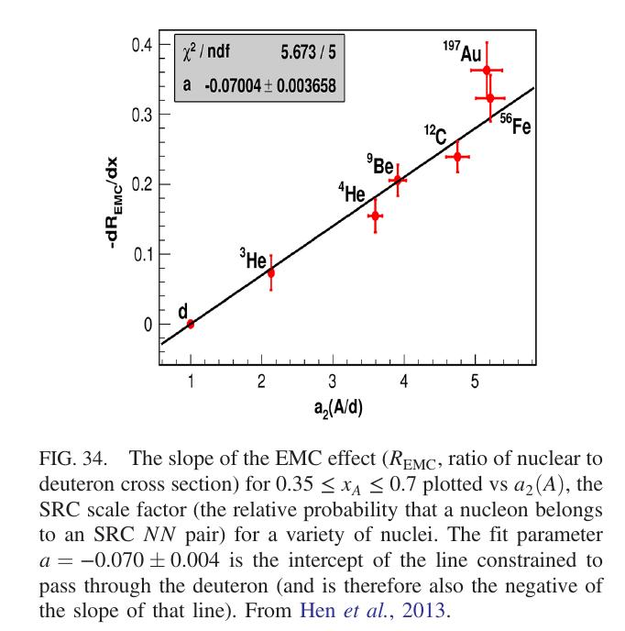
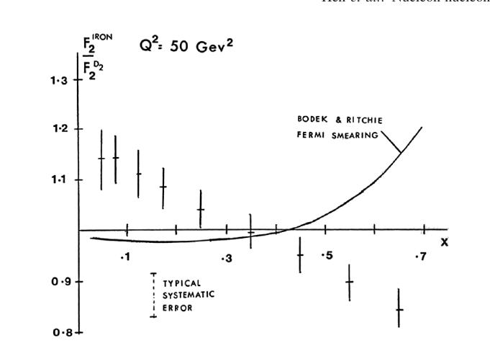
O. Hen et al. Rev. Mod. Phys. 89 (2017) 045002
EMC- effect and SRC

Slide 5
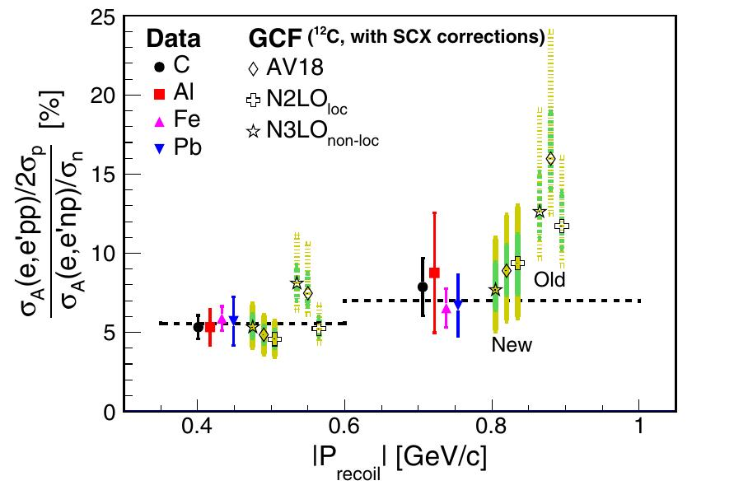
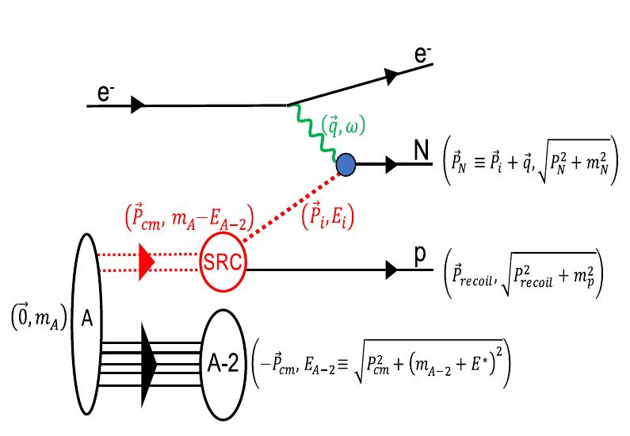
M.Duer et al. PRL 122 (2019) 172502 (CLAS Collaboration)
E_{e}=5 GeV,
A(e,e’np), A(e,e’pp)
pn- dominance in SRC NN
E*=0 - 30 MeV

Slide 6
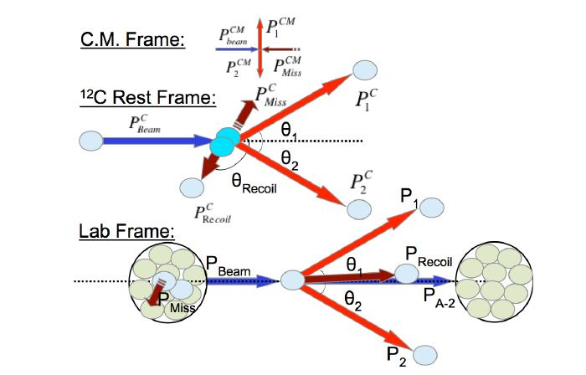
Project of BM@N to study SRC in JINR with 4=GeV/c /nucleon beam of ¹²C and proton liquid target. Inverse kinematics allows to detect all final particles including the residual nucleus.
SRC@BMN proposal
http://bmnshift.jinr.ru/wiki/doku.pho

Slide 7
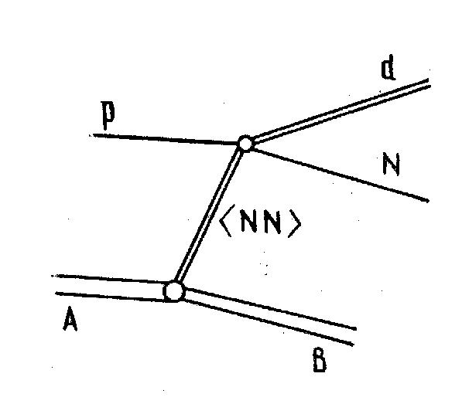
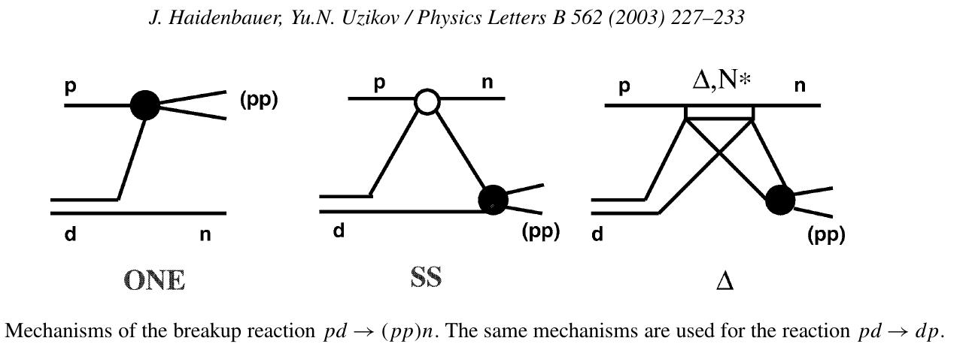
Quasi-elastic knockout of fast deuteron clusters ¹²C(p,pd)¹⁰B and hard pd→dp
M.A.Zhusupov, Yu.N.U. PEPAN 18 (1987) 323; J.Haidenbauer, Yu.N.U. PLB 562 (2003)

Slide 8
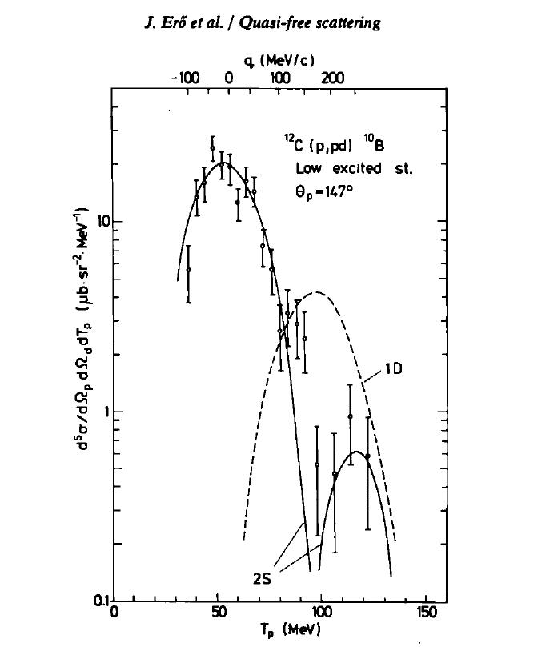
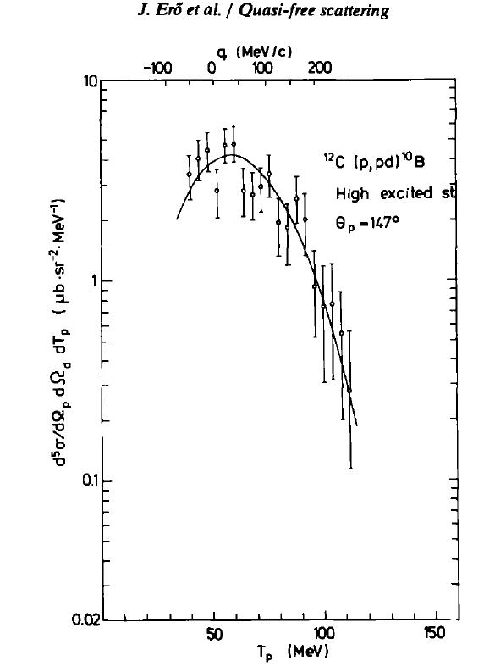
Zero-point at q ≈180 MeV/c
2S
$$↓$$
E*=0 - 5 MeV
0S
E*~ 20 MeV
J.Ero et al. NPA 372 (1981) 371

Slide 9
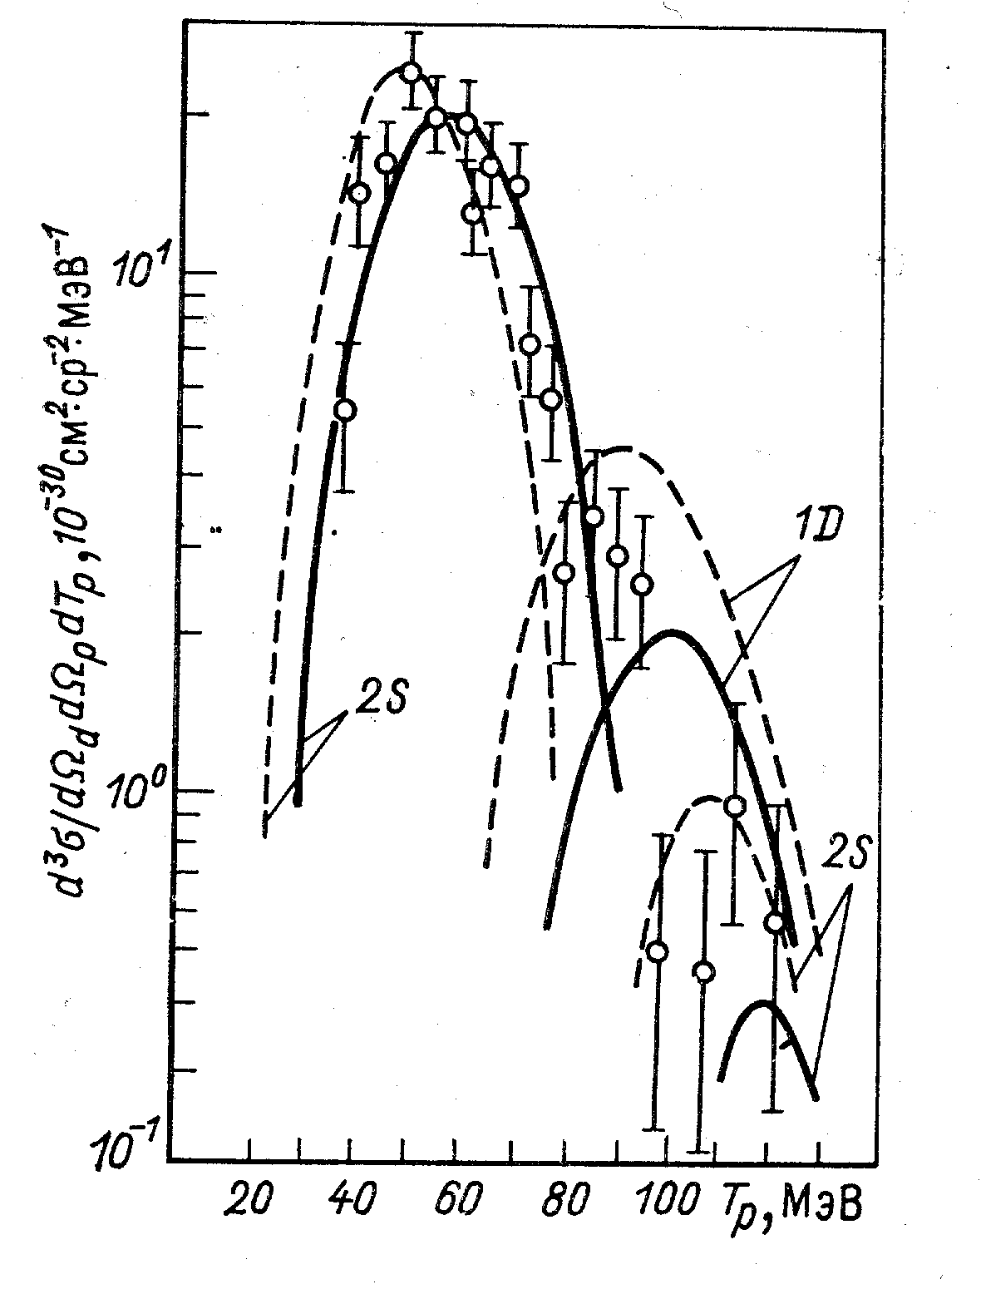
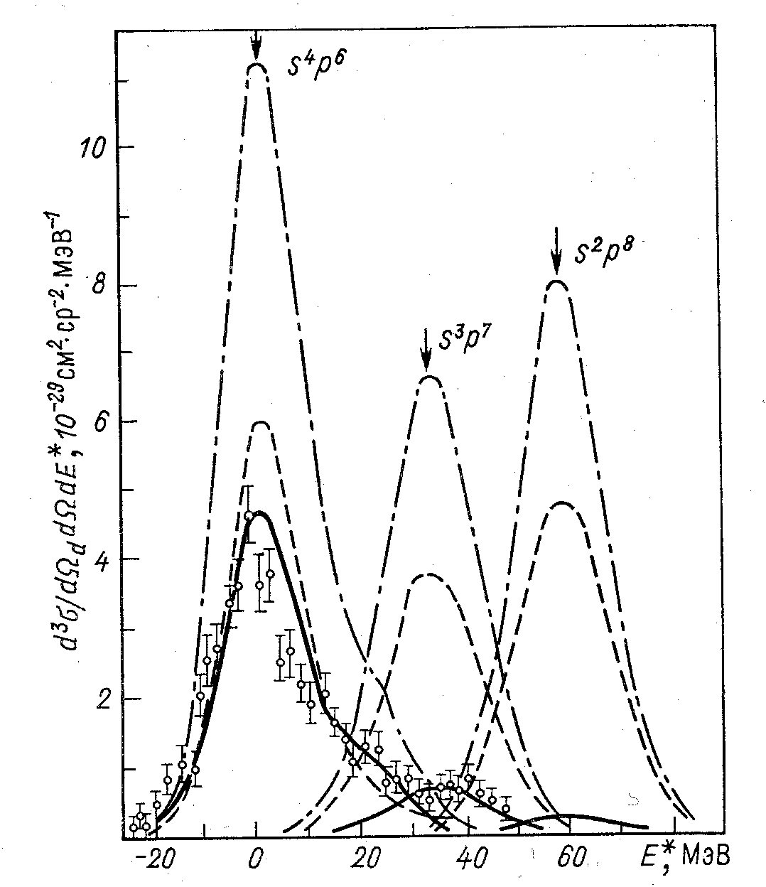
M.A.Zhusupov,O.Imambejkov, Yu.N.U. Izv.AN SSSR (1986)
¹²C(p,pd)¹⁰B (s⁴p⁶)
¹²C(p,pd)¹⁰B(exited states)

Slide 10
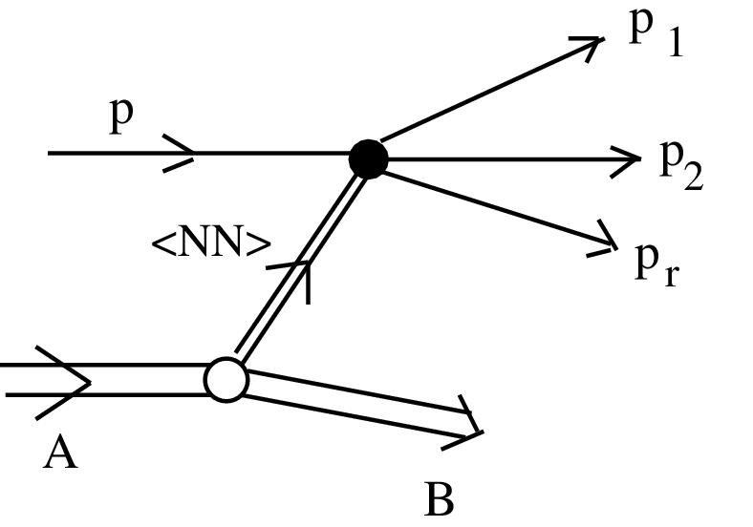
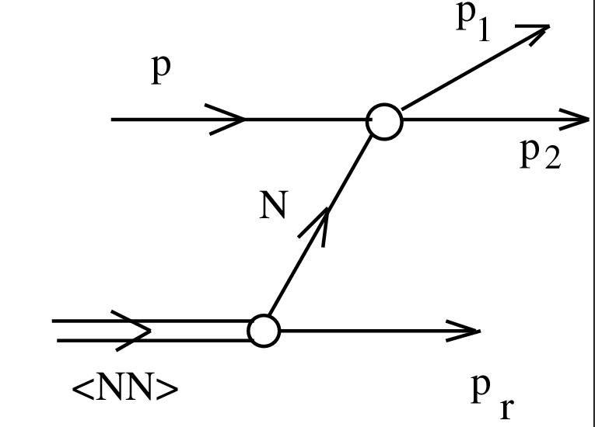
REACTION ¹²C+p → ¹⁰B+ P+P +N

Slide 11
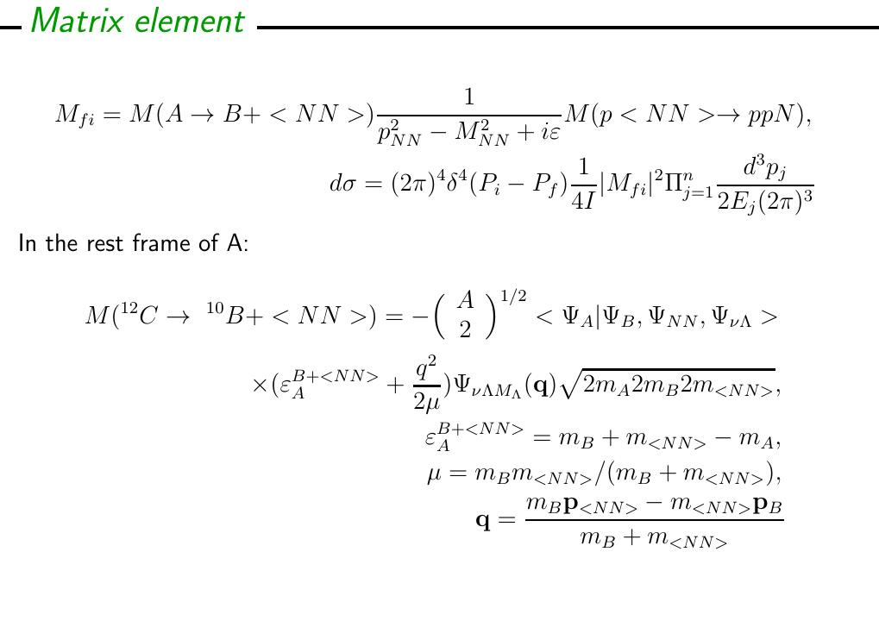

Slide 12
Spectroscopic factors within the translationally-invariant shell model
Mixing shell-model configurations:

Slide 13
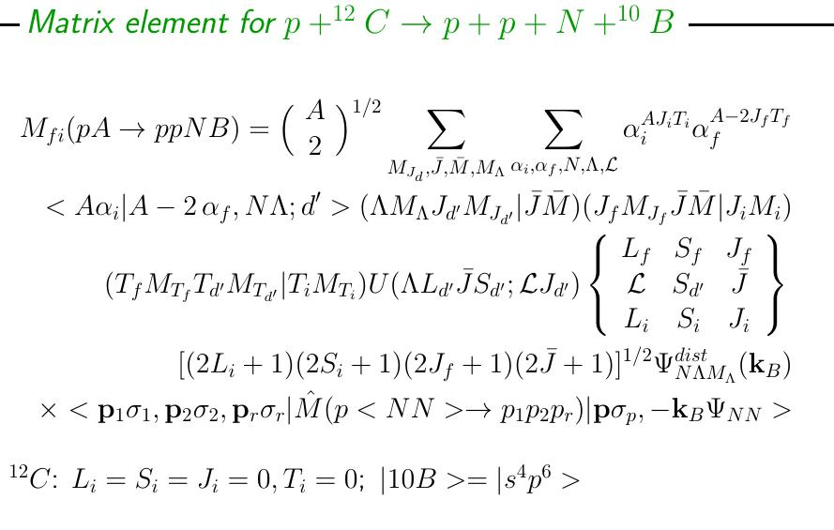

Slide 15
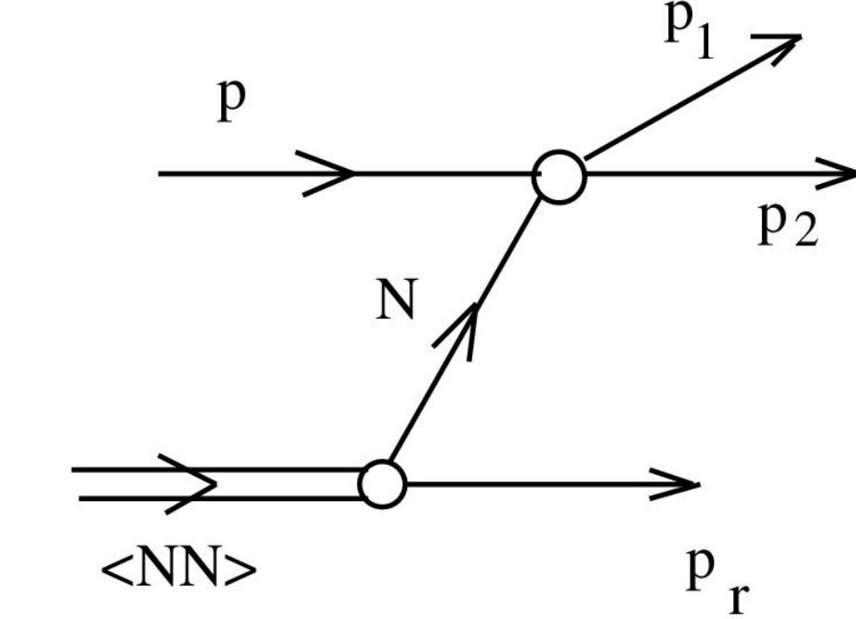

Slide 16
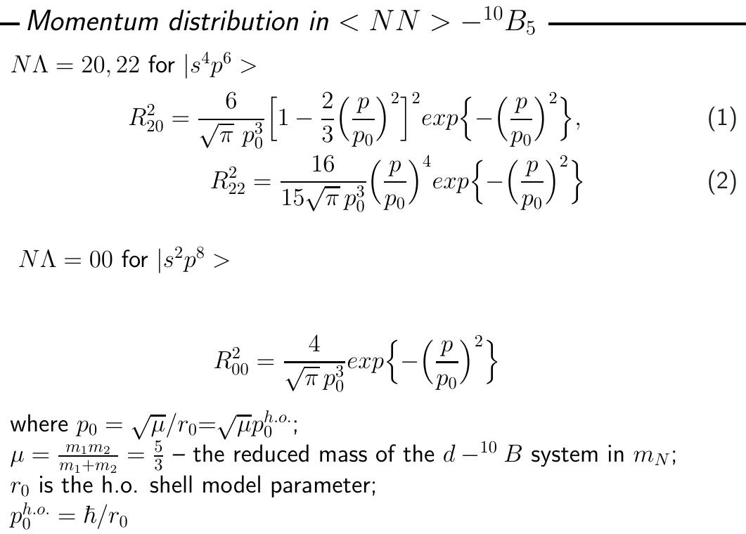

Slide 20
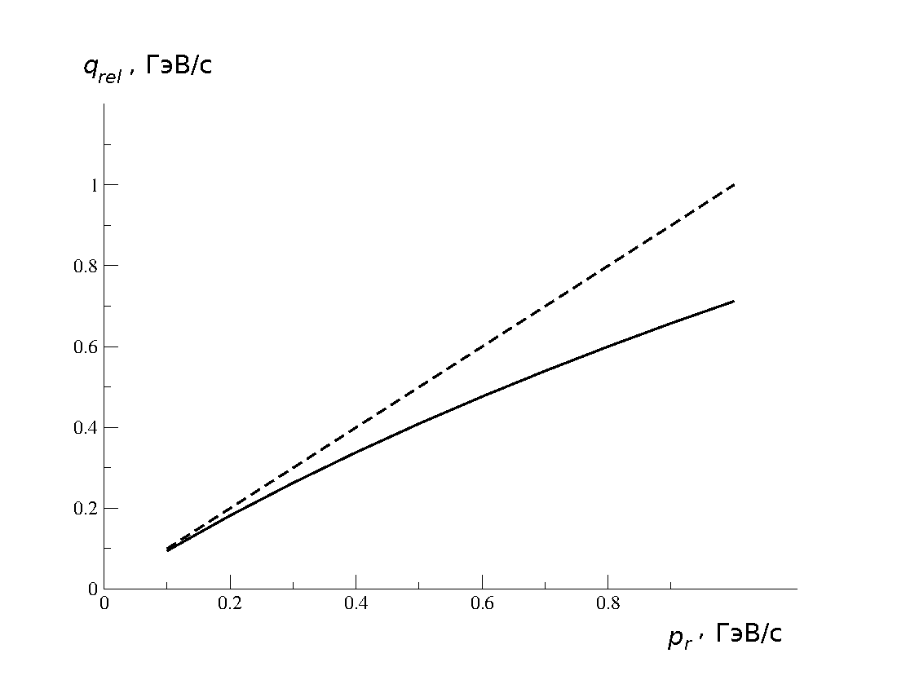
non.rel.
LFD

Slide 21
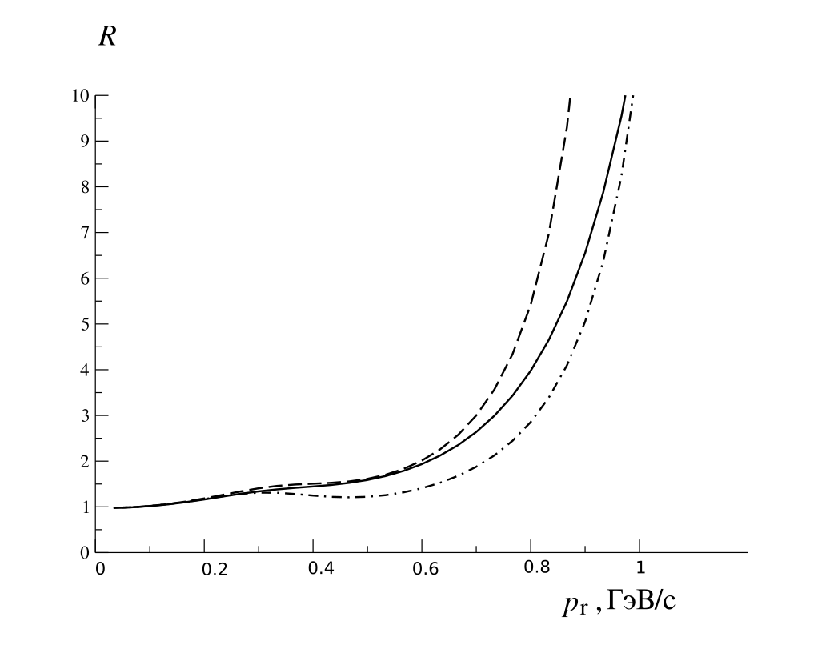
Cd Bonn
Paris
Bonn

Slide 22
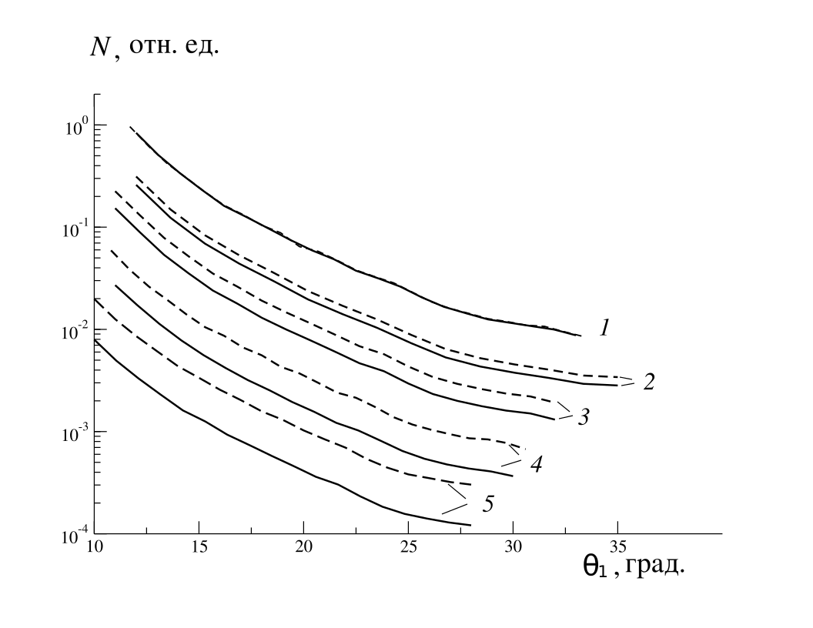
Paris (---), Cd Bonn (full)
P_{B}=0, θ_{r}=6°
p_{r} =0.4 GeV/c
0.5 GeV/c
0.6 GeV/c
0.8 GeV/c
1.0 GeV/c

Slide 23
CONCLUSION
● TISM model with NN-correlations is successful in explanation of the
¹²C(p,pd)¹⁰B data at 670 MeV both for s⁴p⁶ and s²p⁸ configurations of the ¹⁰B.
●Therefore the same model can be applied to the expected BM@N data on the
quasi-elastic knock-ot of the ucleon from SRC NN pair by protons in exclusive
reaction ¹²C+p→ p+p+N +¹⁰B at 4GeV/nucleon.
●The corresponding formalism is developed in the plane-wave-approximation
taking into account relativistic effects in the p+<NN>-p+p+N within the LFD
approach. Mixing configurations with different [f] ^{2T+1 2S+1}L_{J} components of ¹²C
And ¹⁰B are accounted for s⁴p^{A-4.}
● The NN c.m.s. momentum distribution measured and expected in TISM is a problem. Collection of the ¹²C(p,pd)¹⁰B data simultaneously with the¹²C+p-> p+p+p+¹⁰B in the BM@N experiment will be very instructive.
Thank you for attention!

Slide 24
BACKWARD QUASI-ELASTIC pd→(pp)_{s} n SCATTERING

Slide 27
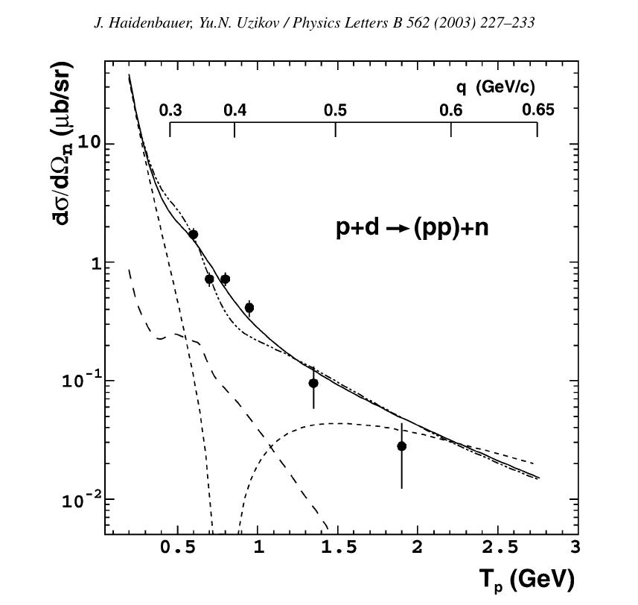
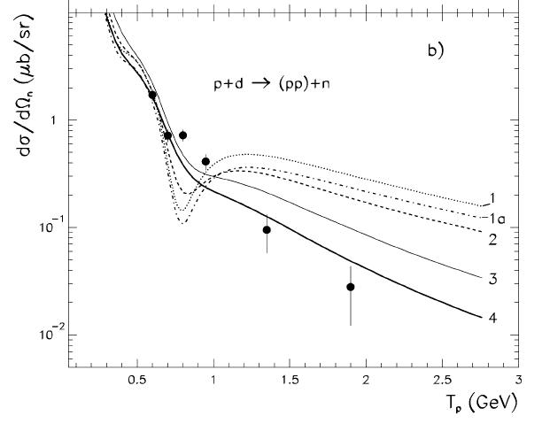

Slide 28
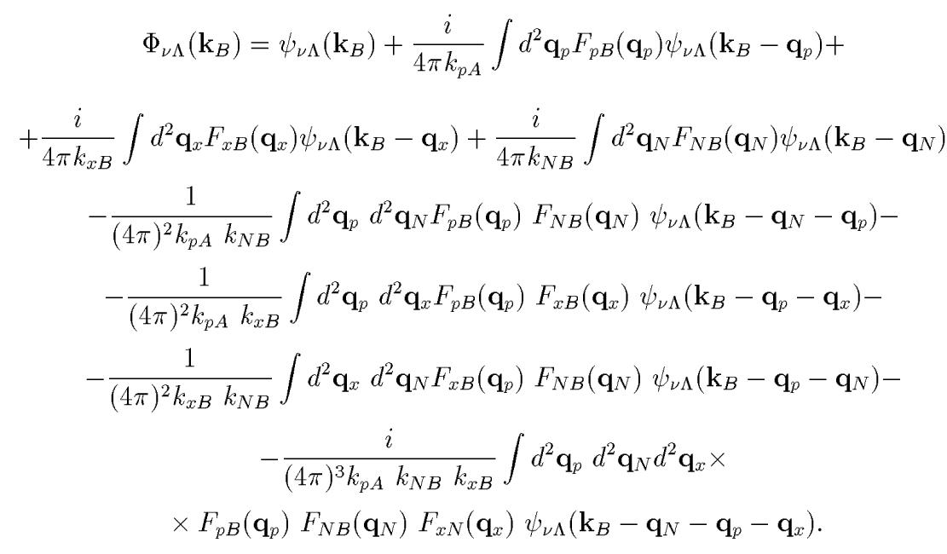

Slide 29
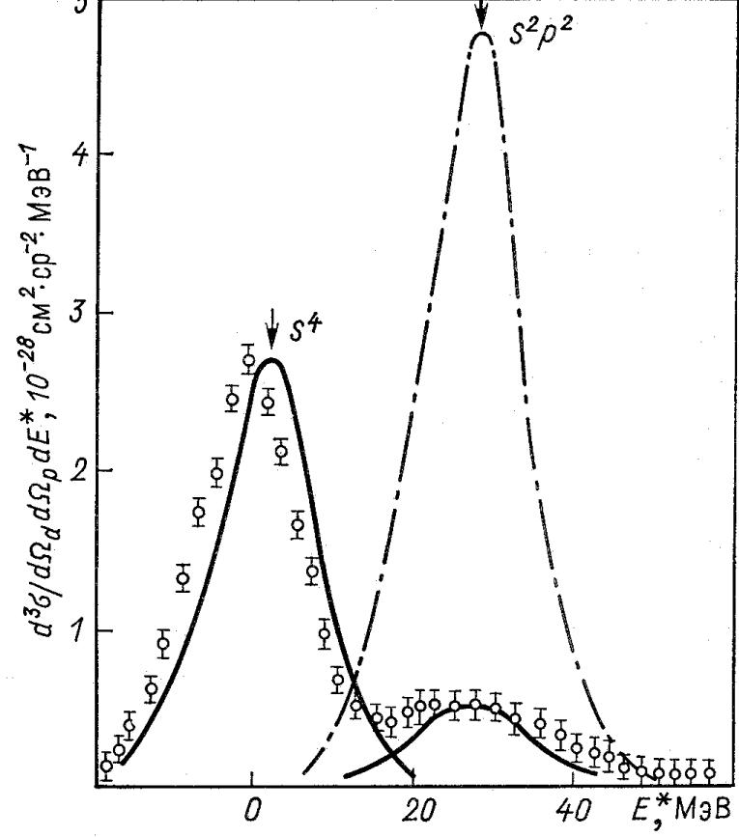
M.A.Zhusupov,O.Imambekov,
Yu.N.U. Izv.AN SSSR (1986)
⁶Li(p,pd)⁴He
Strong suppression of the transitions to the s-shell.
PWIA
Here DWIA= strong absorption
model
DWIA

