Slide 1
NeutrinoS, gut & flavor
and what we unsuccessfully tried to explain (so far)
Davide Meloni
Dipartimento di Matematica e Fisica, Roma Tre
QFTHEP2017

Slide 2

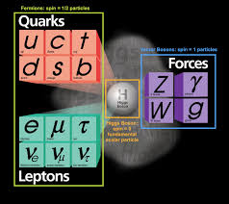
Standard Model particles
the important features for this talk
3 families of increasing mass
quarks and neutrino mixings

Slide 3
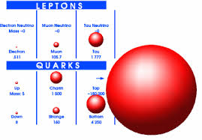

Why neutrinos are so problematic
masses
leptons
quarks
from MeV to GeV
from MeV to 100 GeV
$$\sum_{i=1}^{3}{m_{i}}≤1\left(ⅇV\right)$$
for neutrinos:
mainly from cosmology

Slide 4
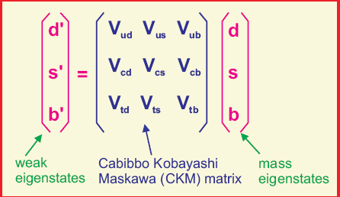
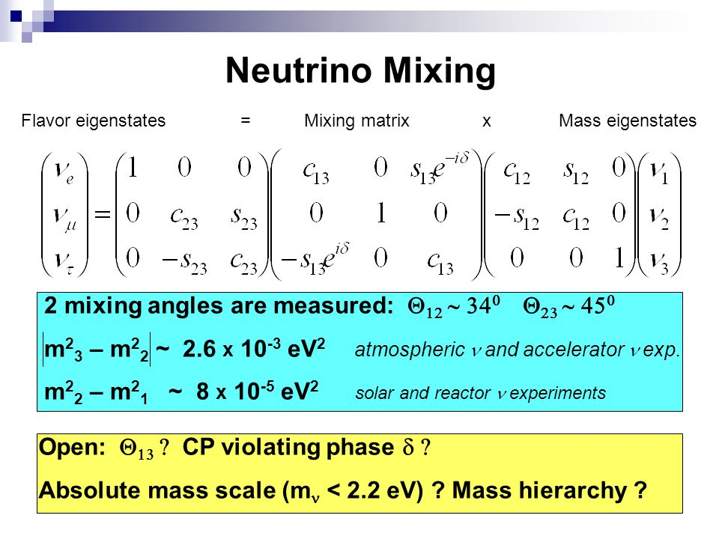
Why neutrinos are so problematic
mixing
Quarks
Neutrinos

Slide 5
Why neutrinos are so problematic
mixing
latest experimental results
Esteban et al. (2017)
a completely different pattern

Slide 6
Flavor conversion
time evolution of a neutrino state
Schroedinger equation

Slide 7
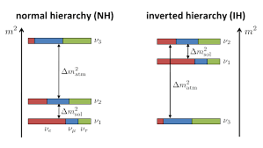
Another mystery: the absolute value of the masses
Oscillation experiments give information on the absolute value of the mass differences only
What the ordering chosen by Nature ?
What is the minimum neutrino mass?
Experiments on nuclear decays with no emission of neutrinos can answer 1. and probably 2.

Slide 8
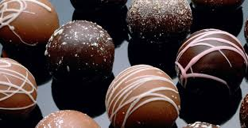



The flavor problem
theoretically challenging
several ideas,
not a clear pattern for the solution !

Slide 9
ν masses
Dirac mass term
Yukawa matrix
right-handed nu
Yukawa matrix
diagonalization
Neutrino mass matrix

Slide 10


ν masses
Majorana mass term
Standard Model fields
Weinberg operator
two singlets
similar to the composition of four ½-spin
vanishing because
of antisymmetry

Slide 11



ν masses
Majorana mass term
in terms of Feynman diagrams we need mediators: tree level realizations
fermionic triplets
singlet fermions
scalar triplets

Slide 12



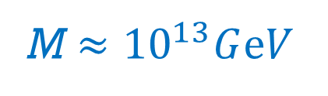


ν masses
Type-I see-saw (both left and right-handed helicity states)
$$m_{D}$$
order of magnitude estimate:
$$m_{ν}≈1ⅇV$$
$$m_{D}≈100 GⅇV$$
M $≈{10}^{13}GⅇV$
neutrino masses can shed light on the physics at a much higher scale!

Slide 13
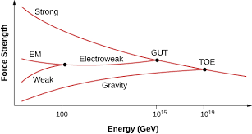
ν masses and Grand Unified Theories
basic idea: at some large energy scale, particles feel a single force
idealized situation
here is where the SM is unified
theory of everything
(forget for the moment, we have problems at much smaller scales)
not far away from the see-saw estimate !

Slide 14
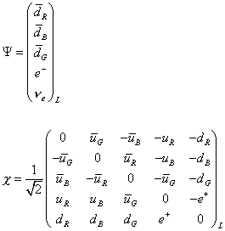
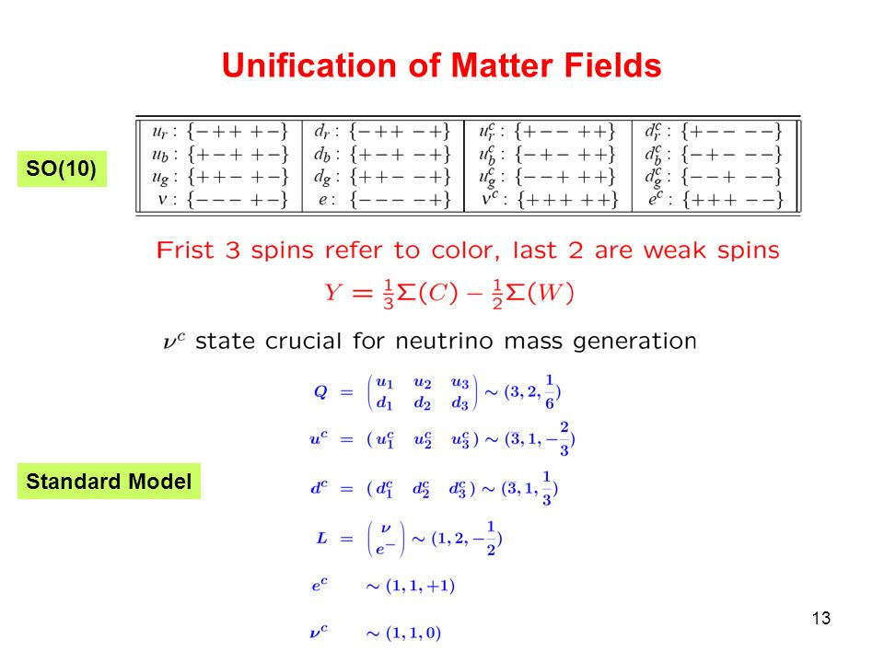
ν masses and Grand Unified Theories
well studied examples: SU(5) and SO(10)
fermions
SU(5)
SO(10)
same field content right-handed neutrinos

Slide 15

ν masses and Grand Unified Theories
if masses are given by the Higgs mechanism, we need SU(2)_{L} Higgs doublets
possible Higgses:
SO(10)
colored states
not relevant here
Yukawa couplings
SU(4) x SU(2)L x SU(2)R

Slide 16










ν masses and Grand Unified Theories
as usual, masses in terms of Yukawas and vevs
$$<$$
$$>$$
$$=$$
ku,d
$$<$$
$$>$$
$$=$$
vu,d
$$<$$
$$>$$
$$=$$
vR

Slide 17


ν masses and Grand Unified Theories
as usual, masses in terms of Yukawas and vevs
$$<$$
$$>$$
$$=$$
ku,d
$$<$$
$$>$$
$$=$$
vu,d
$$<$$
$$>$$
$$=$$
vR
in type-I see-saw: few couplings and yukawas
example: 2-flavor limit
two non-degenerate masses
atmospheric angle suppressed by λ
small parameter

Slide 18
ν masses and Grand Unified Theories
difficult but not impossible…
Altarelli, Meloni (2013)
Dueck, Rodejohann (2013)
and several interesting predictions

Slide 19

Why flavor symmetries?
one example as illustration for all other possibilities: TriBimaximal Mixing (TB)
let us assume that the experimental data are dictated by some fundamental reason
approximate neutrino mixing matrix
good leading order?
U_{TB} diagonalizes this mass matrix
$$U_{BM}^{T}{ m}_{n} U_{BM}={Diag[m}_{n}]$$
only 6 independent real parameters instead of 18: how is it possible?

Slide 20


Why non-abelian symmetries?
the mass matrix shows two invariances:
1-
where
2-
where
groups that have A₂₃ and S_{TB} as elements → arrange invariance in the nu sector!
$$\left[A_{23} , S_{BM}\right] ≠0$$
non abelian groups

Slide 21
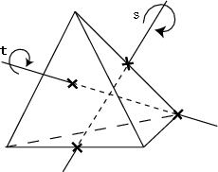
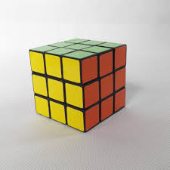
Why non-abelian symmetries?
Permutation groups: S₃, A₄, S₄, A₅ …
A₄: group of
even permutation of four objects
S₄: group of permutation of four objects
objects remain the same after rotations along the symmetry axes

Slide 22

Why non-abelian symmetries?
thanks to Andrea Di Iura
The strategy
Starting point: global invariance
Symmetry breaking
Invariances
Diagonalization
the final result is the mixing matrix

Slide 23
Building concrete models
Main difficult point: break the symmetry in order to ensure the desired mass matrices
enlarged scalar sector!
Altarelli, Feruglio, Merlo (2009)
usual SUSY particles
additional scalars for VEV alignment
new scalar fields

Slide 24
Building concrete models
writing down the most general Lagrangian invariant under the SM gauge group x S₄
symmetry breaking
Dirac mass term
Majorana mass terms
alignment in the flavor spave
U_{BM}
type-I see-saw

Slide 25

Where Flavor meets GUT
Symmetries acting simultaneously but with very different roles
King,Luhn(2013)
matrix elements are related
mass matrices are related
as for BM
as in minimal SU(5)
$$M_{e}=M_{d}^{T}$$

Slide 26
Where Flavor meets GUT
Starting point: the Cabibbo angle plays a fundamental role in neutrino
mixing and charged lepton hierarchy
τ
λ²_{c}
μ
λ²_{c}
e

Slide 27
Where Flavor meets GUT
inspired by the quark-lepton complementarity suggested by the data
1 - flavor symmetry to produce a discrete angle
possible strategy
2 - GUT to introduce the Cabibbo angle in the lepton sector
3 - output
universal corrections
23

Slide 28



Where Flavor meets GUT: in concrete
inspired by the quark-lepton complementarity suggested by the data
Meloni(2011)
usual SUSY particles
but grouped in SU(5) multiplets
new scalar fields
$$\sin^{2}{Θ_{12}}=\frac{1}{2}$$
leading order result
$$\sin^{2}{Θ_{23}}=\frac{1}{2}$$
$$\sin^{2}{Θ_{13}}=0$$

Slide 29

Where Flavor meets GUT: in concrete
The final touch
charged lepton mass matrix
$$U_{l}^{+}{ m}_{e} m_{e}^{+}U_{l}={Diag[m}_{e}^{2} ]$$
charged lepton rotation

Slide 30
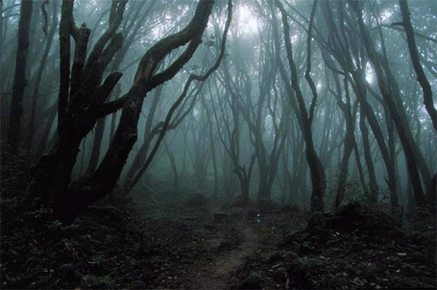
Conclusions
I'm lost in a forest
All alone
(The Cure - 1980)

Slide 31
Additional slides

Slide 32
ν masses
Type-II see-saw
Type-III see-saw

Slide 33
ν masses and Grand Unified Theories
Well studied examples: SU(5) and SO(10)
fermions
SU(5)
SO(10)
same field content right-handed neutrinos
24
45
gauge bosons

Slide 34
ν masses
standard parametrization
Esteban et al. (2017)

