Slide 1
Semileptonic and nonleptonic decays of B_{c} meson into charmonium states
Issadykov Aidos
in collaboration with: Mikhail A. Ivanov &
Bratislava group
The XXIII International Workshop High Energy Physics and Quantum Field Theory
Yaroslavl, Russia 28.06.2017

Slide 2
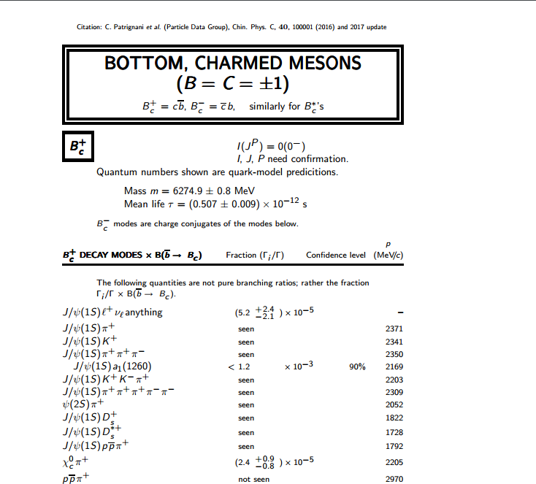
PDG

Slide 3
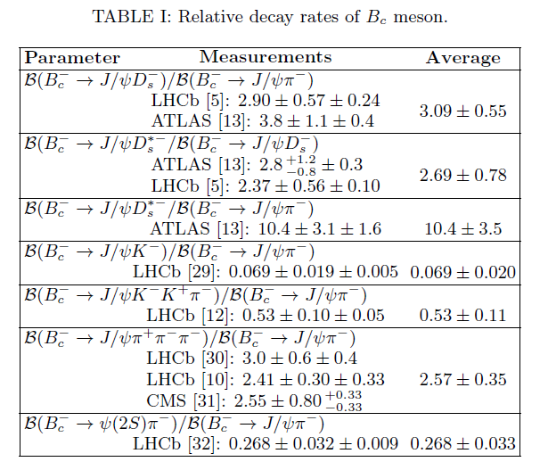
Experimental data

Slide 4
Goal

Slide 5
Covariant quark model

Slide 6
Compositeness condition in covariant quark model

Slide 7
Model parameters
The fitted values of the size parameter Λ in GeV

Slide 8
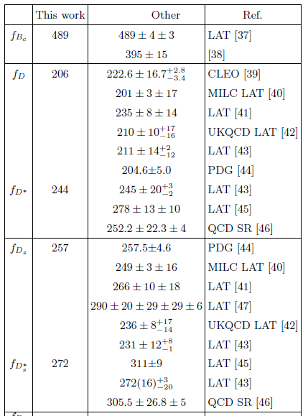
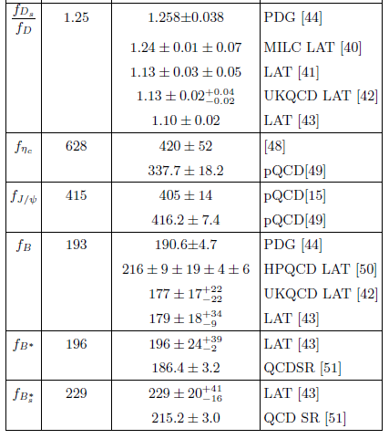
Leptonic decay constants (MeV)

Slide 9
Form factors definition

Slide 10
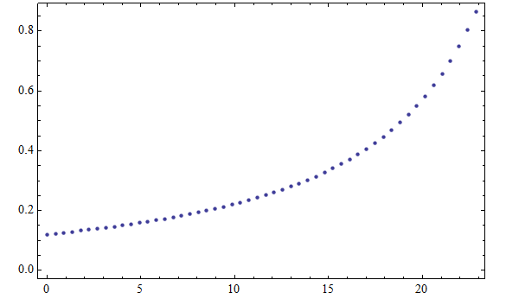
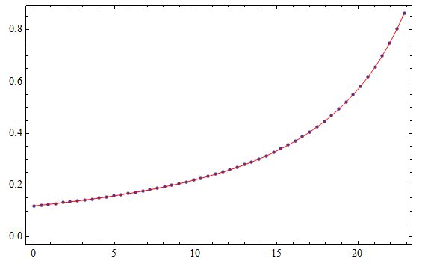
Form factors approximation

Slide 11
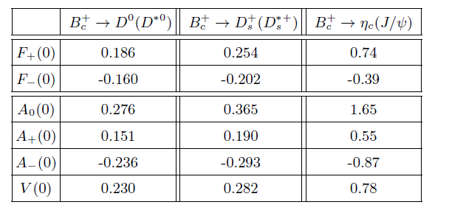
Form factors $B_{c}$ decays

Slide 12
Form factors $B_{c}$ decays

Slide 13
Form factors $B_{c}$ decays

Slide 14
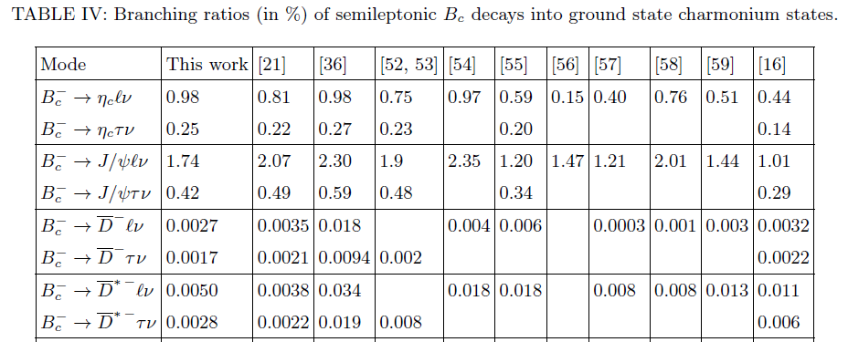
Branching ratios of semileptonic $B_{c}$ decays

Slide 15
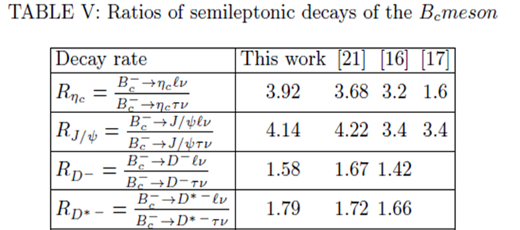
Ratios of semileptonic decays

Slide 16
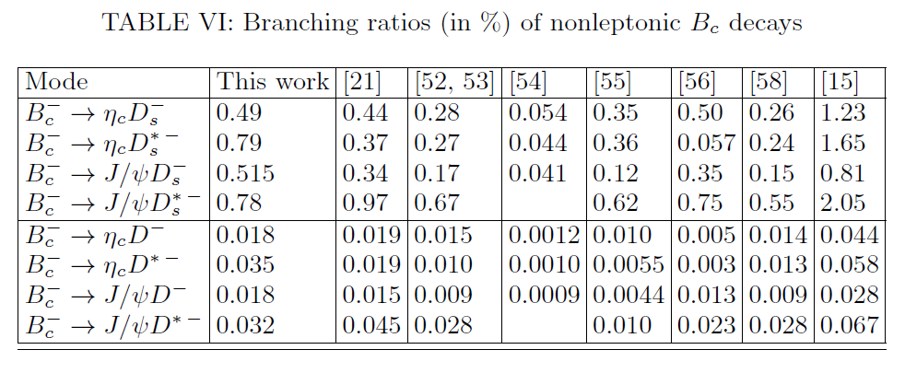
Branching ratios of nonleptonic $B_{c}$ decays

Slide 17
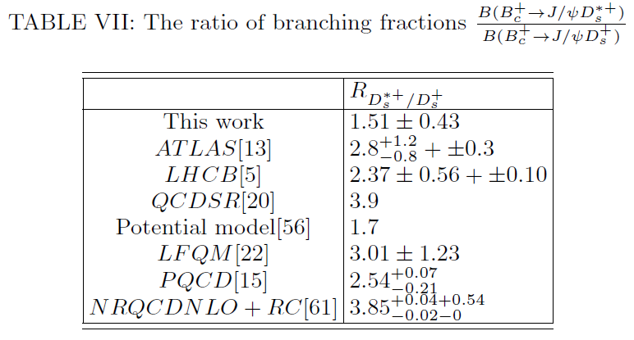
Ratio of nonleptonic decay

Slide 18
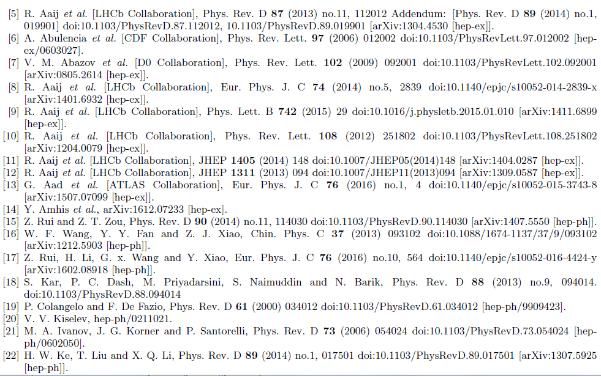
References

Slide 19
References

Slide 20
Thank you!

Slide 21
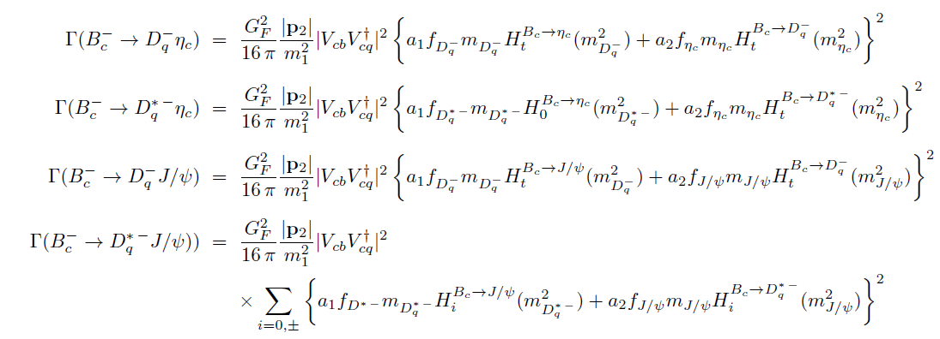
Branching ratios of nonleptonic $B_{c}$ decays

Slide 22
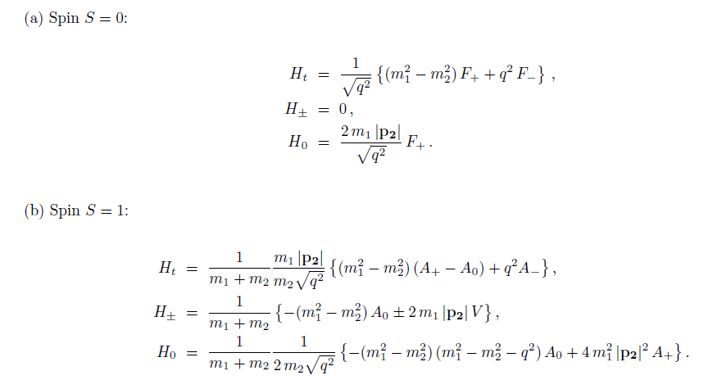
Branching ratios of nonleptonic $B_{c}$ decays

