Slide 1
Top pair production at ILC in
the minimal gauge extension
of the SM
D.E. Vlasenko, V.I. Kuksa
Institute of Physics, Southern Federal University, Rostov-on-Don, Russia
QFTHEP 2011

Slide 2
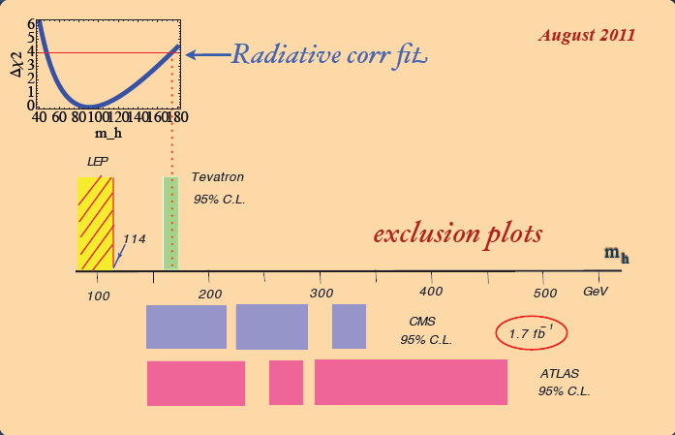
Problems of the SM
1) 3 generations
2) special status of neutrino
Super Kamiokande Observatory, T2K Experiment
3) problem of Higgs boson

Slide 3
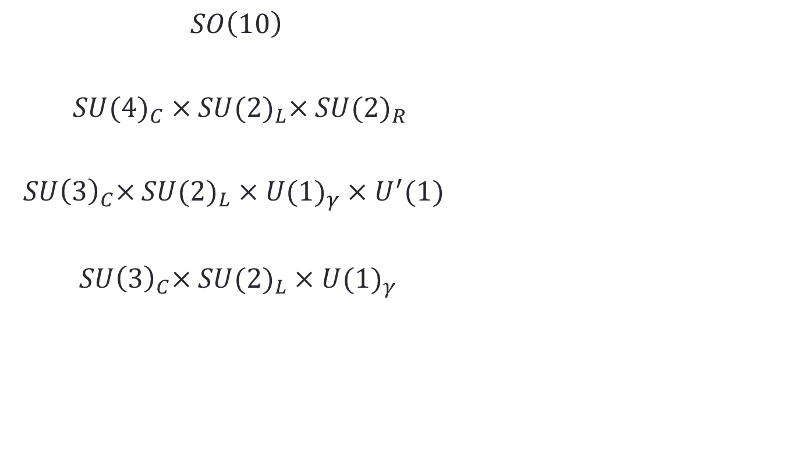
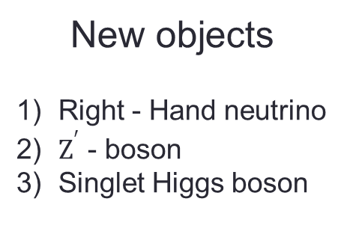
re
Ref. Shaaban Khalil, Center for theoretical Physics British University in Egypt,
“TeV Scale B-L extension of the SM”

Slide 4
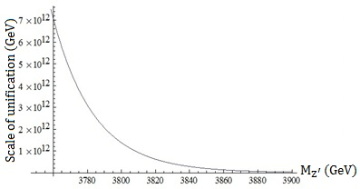
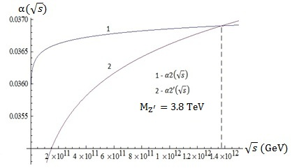
Restriction on new parameters
Experimental restrictions
LEP LHC(Atlas)
${M_{Z^{′}}}/{g^{′}}≳7\left(TeV\right) M_{Z^{′}}≳1.83\left(TeV\right)$
Renormalization group analysis
Fig.1 Dependence of unification scale from $M_{Z^{′}}$
Fig. 2 Dependence of running coupling
constants from $\sqrt{s}$

Slide 5
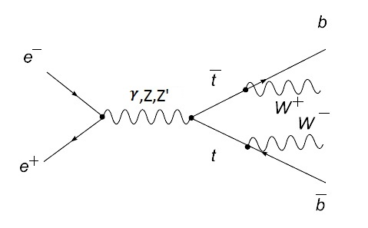
Ref. V.I. Kuksa and R.S. Pasechnik, Int. J. Mod. Phys. A, 24 (2009) 5765;
LEP 2 W–production.

Slide 6
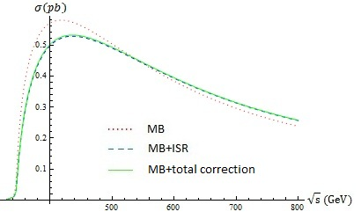
Corrections
1) ISR (J.Fleischer et al., Phys.Rev.D47(1993)830)
2) Running couplings (in one – loop approximation)
3) QCD as a vertex factor (Guo Lei et al., Phys Lett.B662(2008)150;
hep-ph/0802.4124)

Slide 7
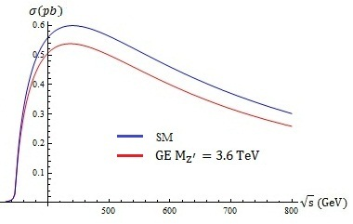
Deviation from the SM prediction
Fig.4 The $t\overline{t}$ cross section in the SM and the minimal
gauge extension of the SM.
$Z^{′}$ has large mass nevertheless caused effect is very significant.

Slide 8
Conclusion
1) Existing restrictions allow to concretize the cross section of the top-pair production.
2) The model approach we have used significantly simplifies calculations.
3) Despite the fact that $Z^{′}$ mass is significantly more than other particles masses, we have the large effect starting from approximately 400 GeV.

Slide 9
Thank you
for your attention!

