Slide 1
ATLAS overview & recent results
QFTHEP'2011
Sochi
A.Zaitsev, Protvino
for ATLAS collaboration

Slide 2
Scope
The ATLAS detector
Combined performance
Tracking
Flavor Tagging
Jet/EtMiss
Tau
Muon combined
e/gamma
Results
Standard Model → Pavel Jes
Higgs → Henso Abreu
Supersymmetry → Alexey Myagkov
Exotics → Alexey Myagkov
Top Physics
B Physics
Heavy Ions

Slide 4
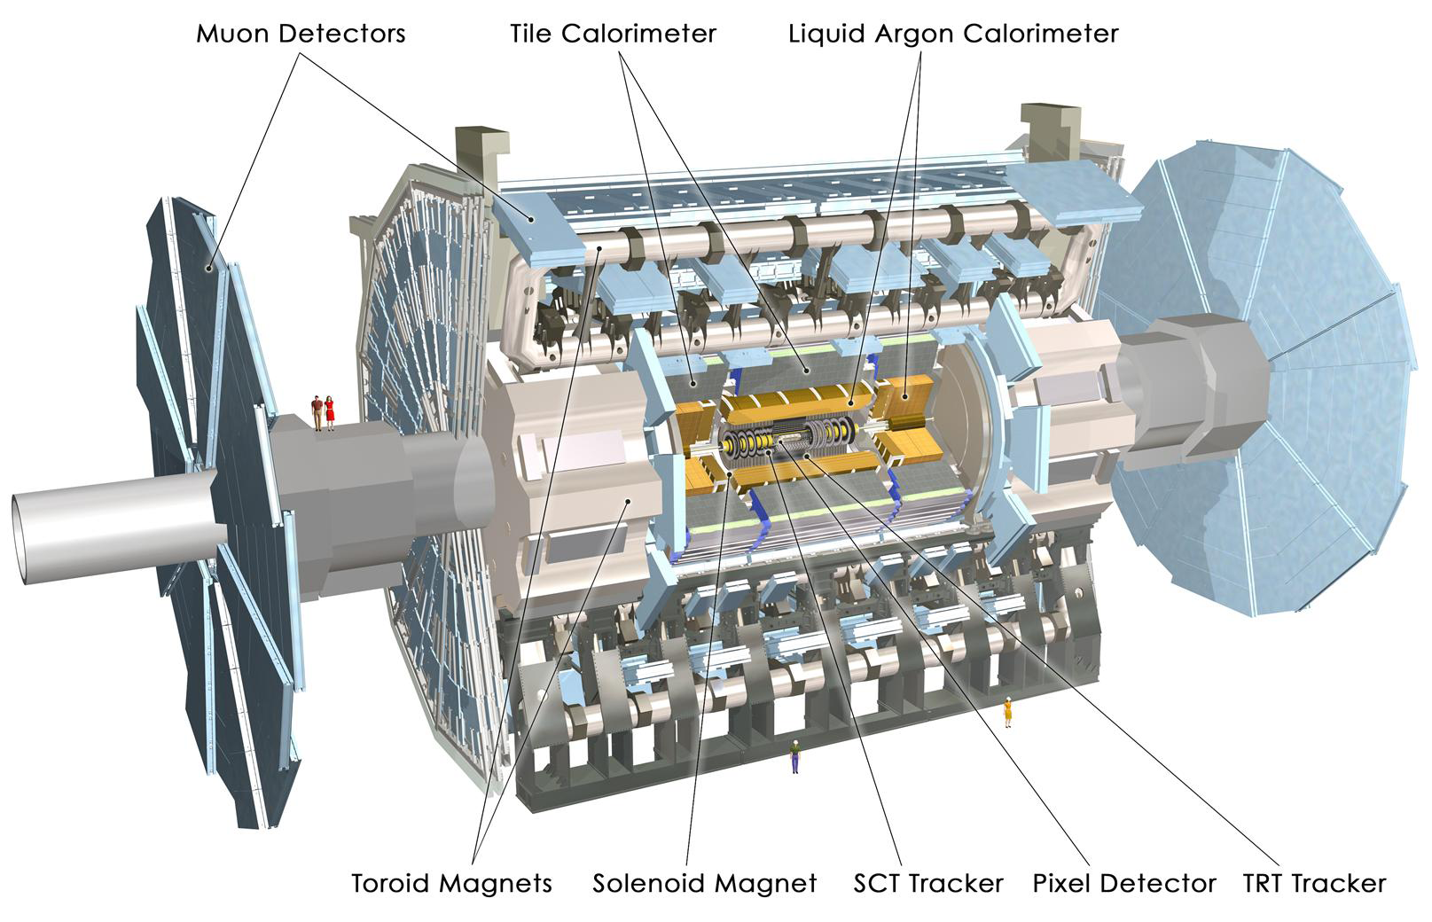
The ATLAS detector
4 Superconducting magnets:
Central Solenoid (B= 2T)
3 Air core Toroids
HAD calorimetry (|η|<5):
segmentation, hermeticity
Fe/scintillator Tiles (central), Cu/W-LAr (fwd)
Trigger and measurement of jets and missing ET
E-resolution: σ/E ~ 50%/√E ⊕ 0.03
Muon Spectrometer (|η|<2.7)
Muon trigger and measurement with
momentum resolution < 10% up to Pμ ~ 1 TeV
EM calorimeter: Pb-LAr Accordion
e/γ trigger, identification and measurement
E-resolution: σ/E ~ 10%/√E
Inner Detector (|η|<2.5, B=2T):
Si Pixels, Si Strips & Transition Radiation detector
tracking and vertexing, e/π separation, dE/dX
Momentum resolution: σ/pT ~ 3.8x10-4 pT (GeV) ⊕ 0.015

Slide 5
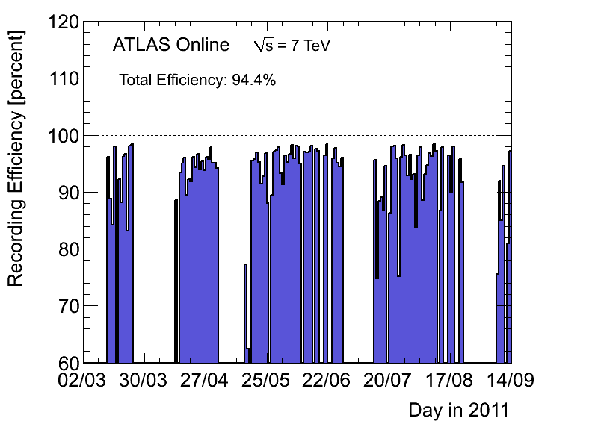
Data Taking Efficiency
the luminosity delivered (between the declaration of stable beams
and the LHC request to turn the sensitive detectors off)
Efficiency = ---------------------------------------------------------------------------------
the luminosity recorded by ATLAS

Slide 6
Operational fraction
Subdetector | N Channels | Operational Fraction
Pixels | 80 M | 96.9%
SCT Silicon Strips | 6.3 M | 99.1%
TRT Transition Radiation Tracker | 350 k | 97.5%
LAr EM Calorimeter | 170 k | 99.5%
Tile Calorimeter | 9.8 k | 97.9%
Hadronic Endcap LAr Calorimeter | 5.6 k | 99,6%
Forward LAr Calorimeter | 3.5 k | 99.8%
MDT Muon Drift Tubes | 350 k | 99.8%
CSC Cathode Strip Chambers | 31 k | 98.5%
RPC Barrel Muon Chambers | 370 k | 97.0%
TGC Encap Muon Chambers | 320 k | 98.4%
LVL1 Calo Trigger | 7160 | 99.9%
LVL1 Muon RPC Trigger | 370 k | 99.5%
LVL1 Muon TGC Trigger | 320 k | 100%

Slide 7
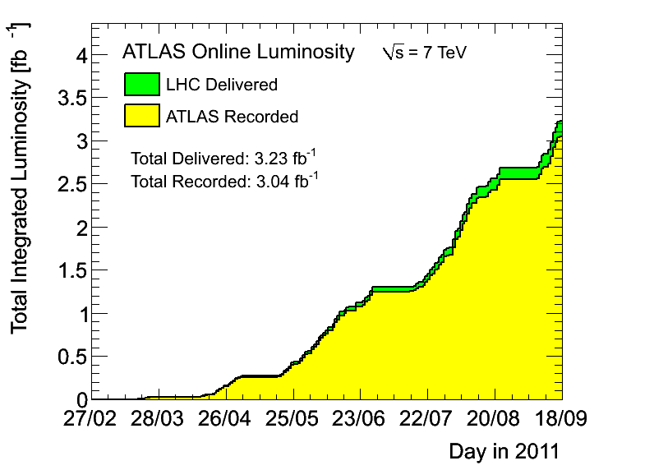
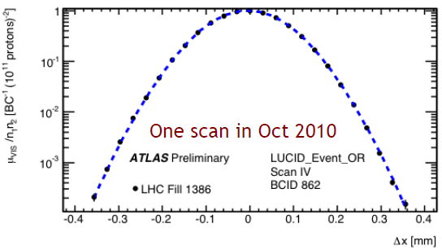
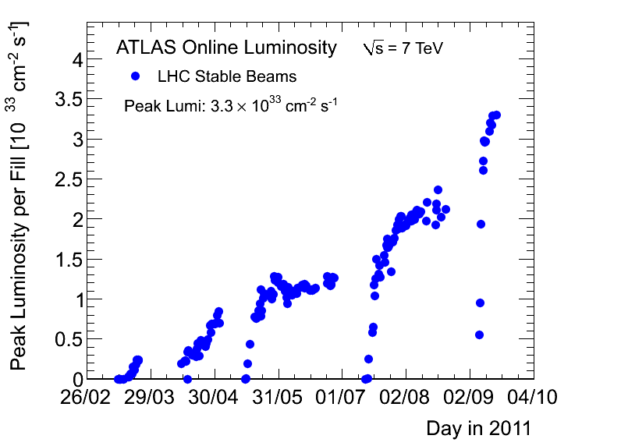
Luminosity
The maximum instantaneous luminosity: 3.3x10³³ cm⁻² s⁻¹
Delivered Luminosity: 3.23 fb⁻¹
ATLAS Ready Recorded: 3.04 fb⁻¹
Absolute luminosity calibration by van der Meer scans
ΔL/L = ±3.4% (2010, prel)
ΔL/L = ±3.7% (2011, prel)

Slide 8
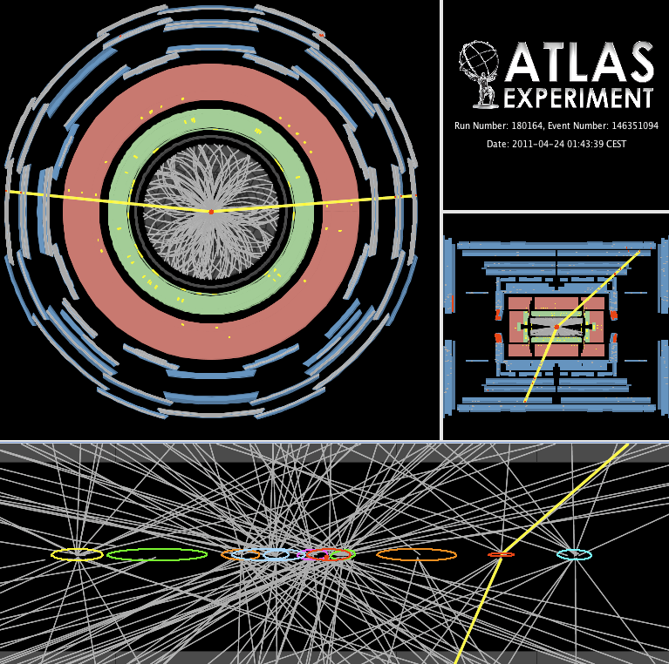
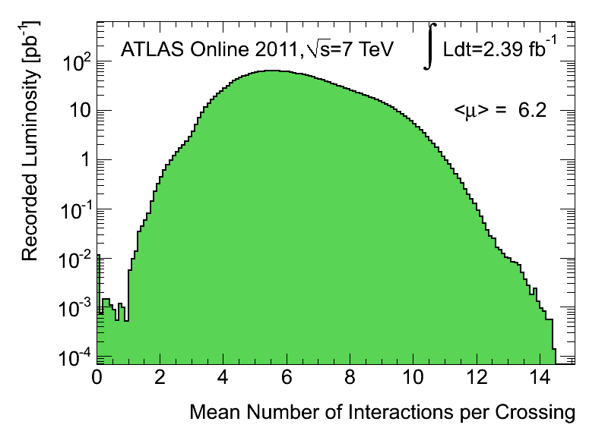
Pile-up
50 ns bunch trains for ~all 2011 data
Substantial in- and out-of-time pileup
Much progress understanding impact on performance, with data & simulation
Z→μμ event with 11 primary vertices

Slide 9
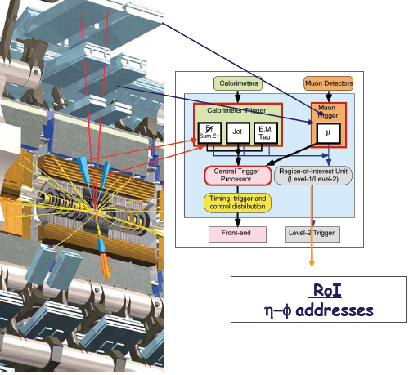
Trigger
Level-1:
Implemented in hardware
Muon + Calo based coarse granularity
e/γ, μ, π, τ, jet candidate selection
Define regions of interest (ROIs)
Typical rates
L1: 60 kHz
L2: 5 kHz
EF: 300-400 Hz
Level-2:
Implemented in software
Seeded by level-1 ROIs, full granularity
Inner Detector – Calo track matching
Event Filter:
Implemented in software
Offline-like algorithms for physics
signatures
Refine LV2 decision
Full event building
L.Mapelli

Slide 10
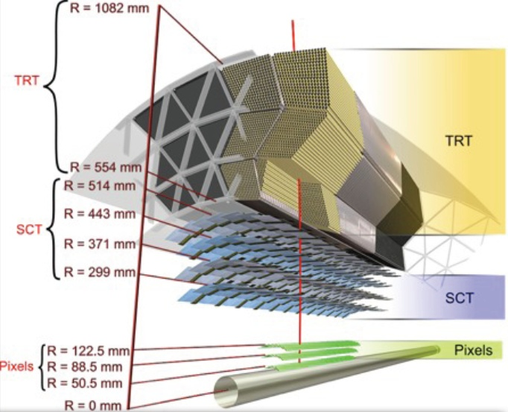
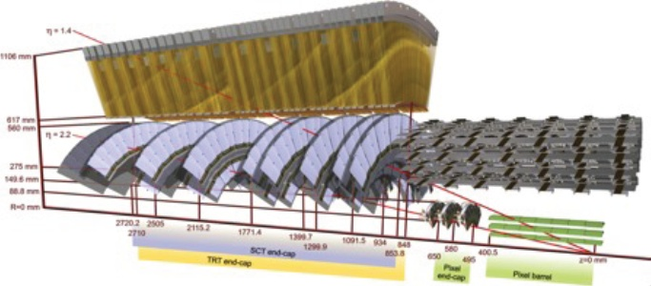
Inner detector
Tasks:
Precision tracking with a hermitic silicon tracker covering over 5 units in eta
Primary vertex reconstruction
b-tagging
reconstruction electrons and converted photons,
electron identification with TRT
tracking of muons combined with toroid Muon Spectrometer
V0, b- and c-hadron reconstruction, ...
dE/dx from T.o.T. in Pixels and TRT
fast tracking for high level trigger

Slide 11
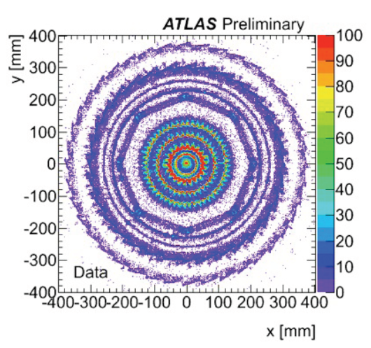
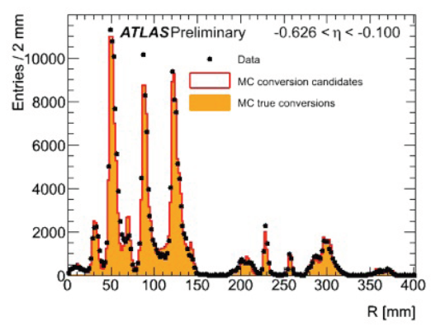
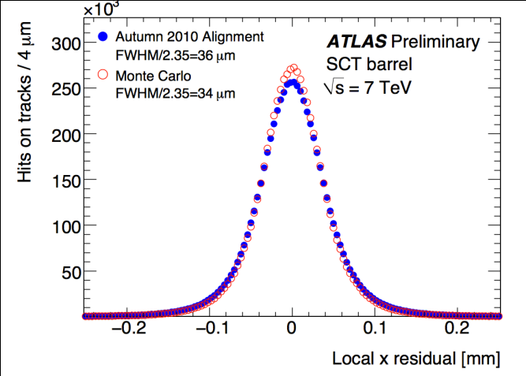
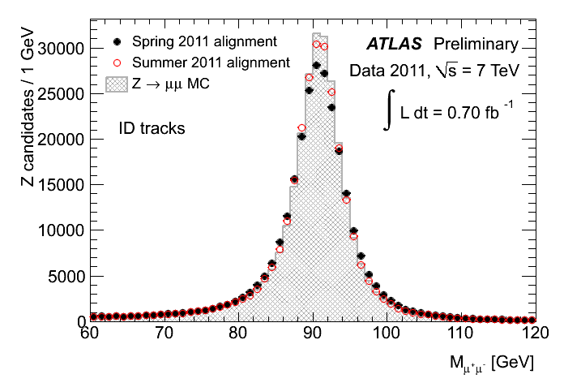
ID Performance
Material studies
γ-conversion
hadronic interactions
Very detailed description
Detector alignment
small residual misalignment
error scaling to allow for residual misalignments in fit
Z → μμ from the Inner Detector track of the combined muons,
MC: Ideal alignment
Black: spring 2011 alignment
Red: updated alignment
Residuals of the SCT barrel modules

Slide 12
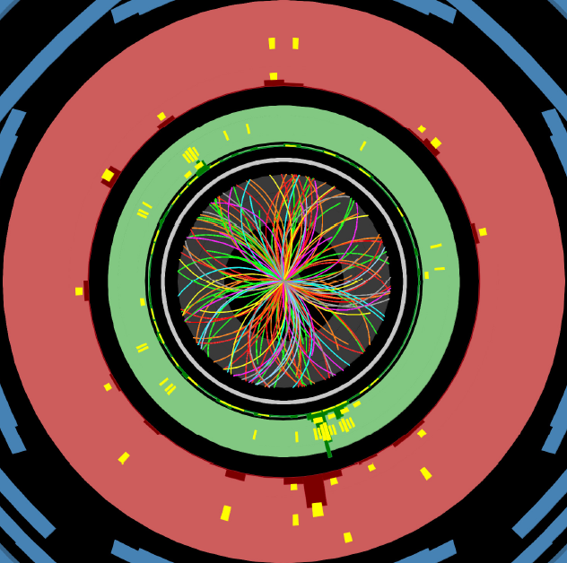
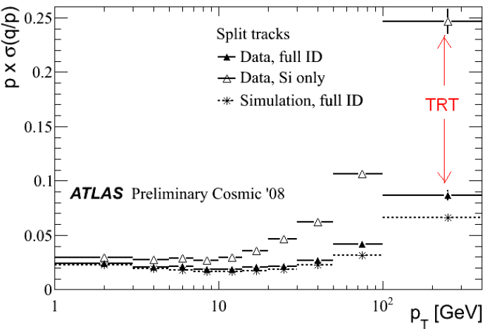
ID Performance
Reconstruction, p_{T} resolution
The inner tracking system measures charged particle tracks at all over the pseudorapidity region η < 2.5 using the pixel, SCT and TRT detectors. A pattern recognition algorithm that starts with the silicon information and adds hits in the TRT. This “inside-out" tracking procedure selects track candidates with transverse momenta above 100 MeV .
One further step starts from the TRT and works inwards adding silicon hits as it progresses. In this second step, tracks from secondary interactions, such as photon conversions and long-lived hadron decays, with transverse momenta above 300 MeV are recovered.

Slide 13
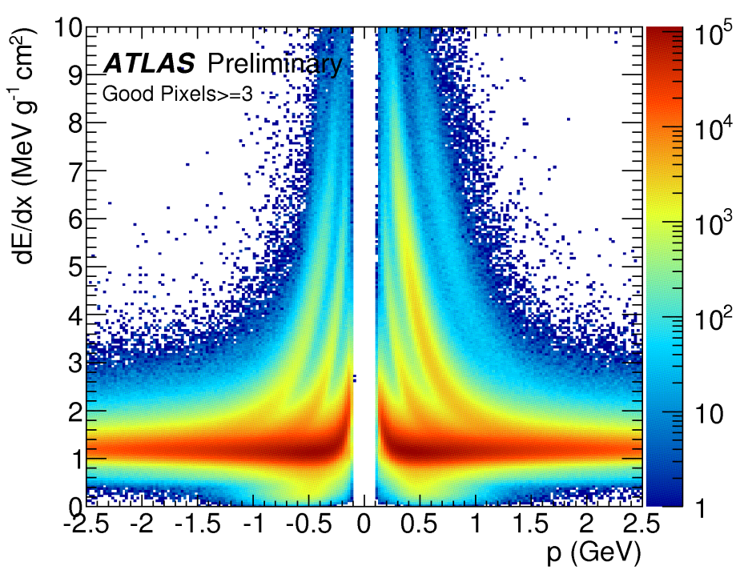
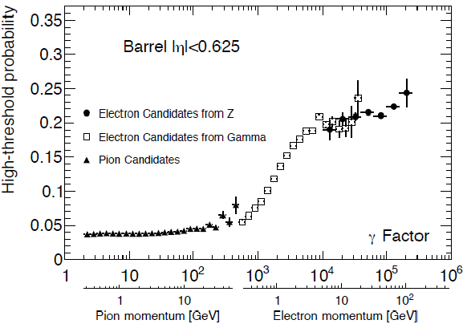
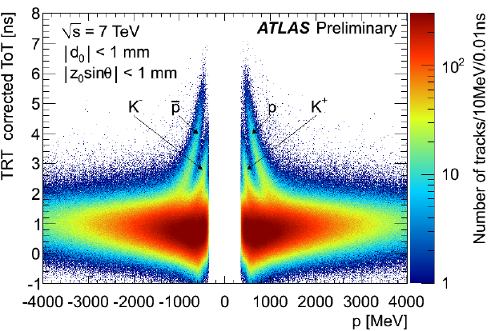
ID Performance
Particle identification
Energy loss in Pixel
TRT High Threshold hit fraction provides electron/hadron discrimination over the momentum range between 1 and 150 GeV/c
Time over Threshold (ToT) is sensitive to dE/dx of charged particle, allowing an independent method of particle identification.

Slide 14
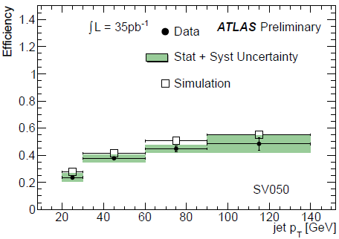
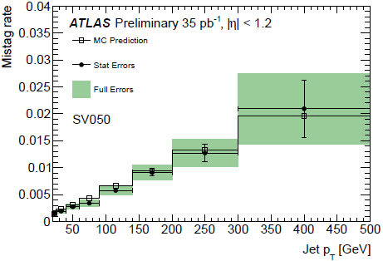
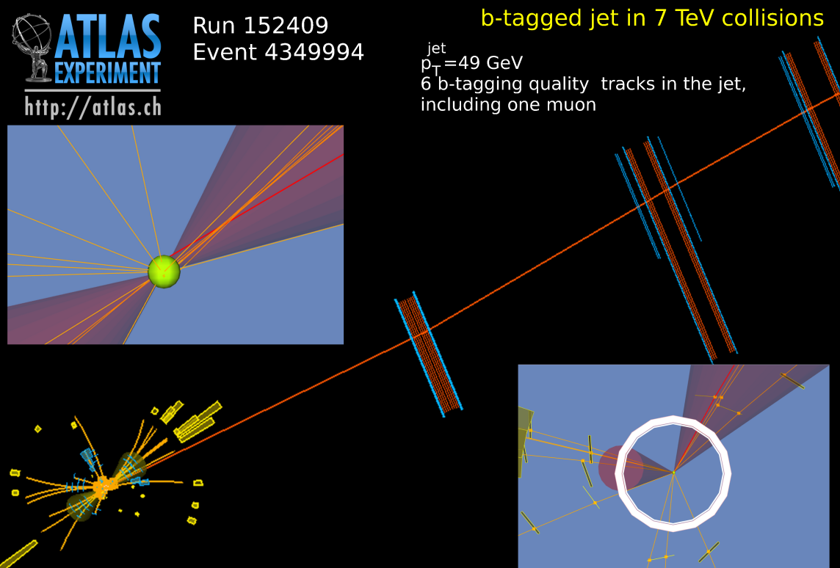
B-tagging
The b-tag efficiency and mistag rate of b-tagging algorithms have been measured with a number of complementary methods using data from the ATLAS detector. Good consistency is observed between the results of all methods.
This jet has all the characteristics of a b-jet with a semi-leptonic decay (to a muon).
Muon Tagger: A combined muon with the following properties:
Muon pT = 6 GeV
Muon d0 = 610 microns
Muon d0/sigma(d0) = 15
The muon is part of the secondary vertex.

Slide 15
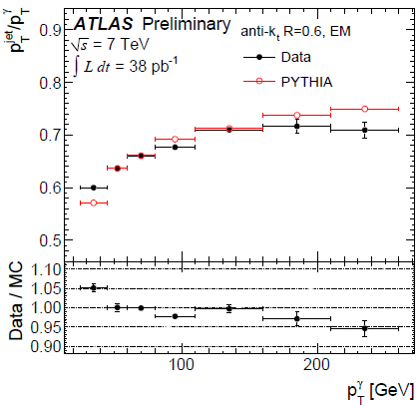
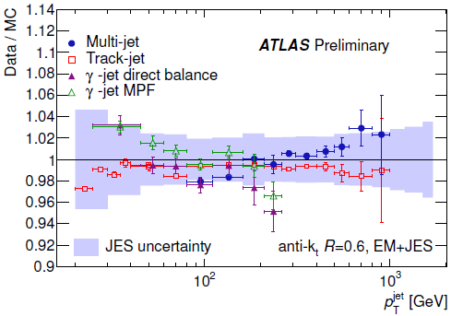
Jet reconstruction
Anti-kT algorithm with resolution parameter R=0.4 – 1.2
reconstruct jets with simple cone-like geometrical shape from calorimeter clusters or charged particle tracks
Infrared and co-linear safe
Due to the non-compensating nature of the calorimeter, signal losses due to noise thresholds and in dead material the jet energy needs to be calibrated.
Jet energy calibration is validated in-situ by:
direct transverse momentum balance between a jet and a photon
photon balance using the missing transverse momentum projection
response to single isolated hadrons
multi-jet balance technique
For jet transverse momenta between 60 and 800 GeV the uncertainty is below 2.5%.
Jet response as determined by the direct p^{T} balance technique
Jet energy scale uncertainty as a function of p ^{jet}_{T} in 0 ≤ |η| < 1.2

Slide 16
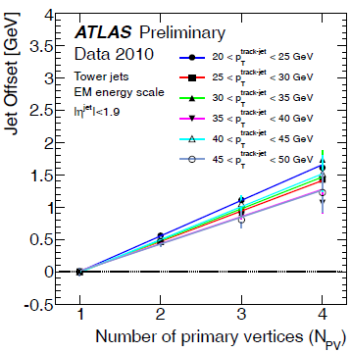
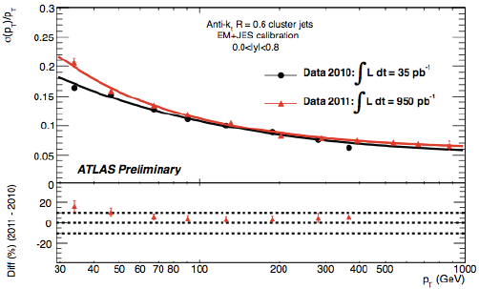
Jet p_{T} resolution
Corrections for jet p_{T} offset
from pile-up is about
0.5 GeV/additional vertex
Jet p_{T} resolution for QCD jets was measured by Jet p_{T} balance method.
For p_{T} ~ 1 TeV
σ(p_{T} )/ p_{T} = 6%
Fractional jet energy resolution as a function of the average jet transverse momenta for events with two jet in the same rapidity bin for EM+JES calibration with 2011 (red) and 2011 (black) data.

Slide 17
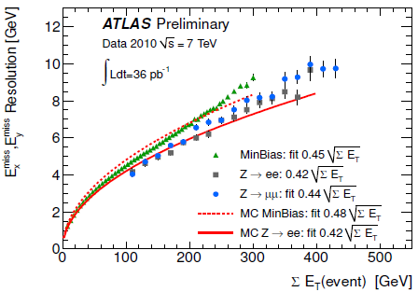
E_{T}^{miss}
E_{x}^{miss} and E_{y}^{miss} resolution as a function of the total transverse energy was measured in minibias events as well as in the events with W(lν) or Z(ll).
It follows simple low
σ(E_{x}^{miss} ) = σ(E_{y}^{miss} ) = 0.45 √ ΣE_{T}^{miss}

Slide 18
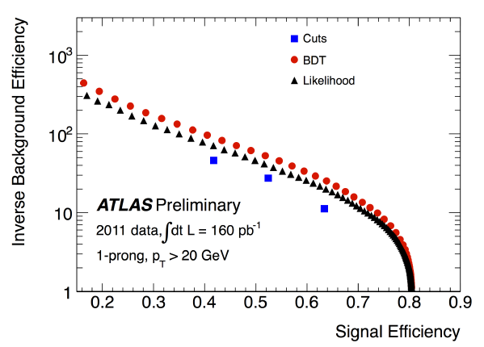
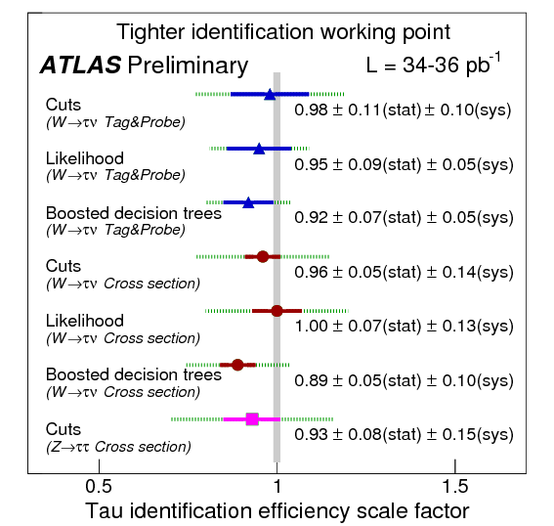
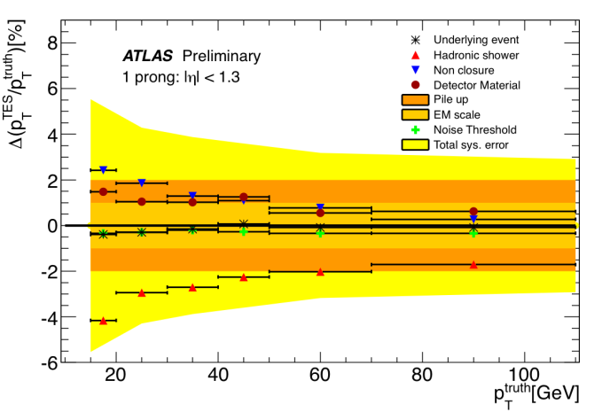
Tau-lepton
Tau leptons are recognized in the ATLAS detector via their hadronic decays.
Tau leptons versus QCD jets:
number of final state particles
width of the energy depositions in the calorimeter
displacement of the secondary vertex
small invariant mass
The tau identification efficiency has been measured in data using W→τν and Z →ττ events
The tau energy scale is obtained from the measured transverse momentum by scaling it to its expected value from Monte Carlo simulation of tau decays.
Systematic uncertainty on the tau energy scale ~2%
Inverse background efficiency (in dijet data) versus signal efficiency (in W->τν and Z->ττ Monte Carlo samples)

Slide 19
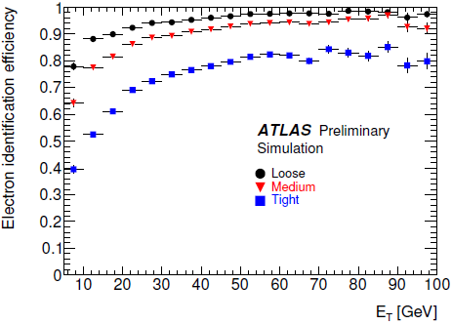
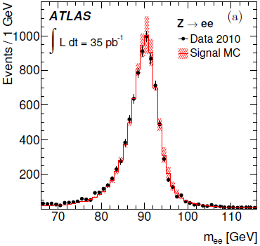
e/γ
Electron identification
Three reference sets of requirements provide progressively stronger jet rejection :
Loose: shower shape in the second layer of the EM calorimeter and energy leakage into the hadronic calorimeters.
Medium: the energy deposit patterns in the first layer , track quality variables, distance to the primary vertex and a cluster-track matching
Tight: the ratio of cluster energy to track momentum, the number of hits in the TRT, the ratio of high-threshold hits to the total number of hits in the TRT, at least one hit in the first layer.
MC efficiency and resolution agreed with data

Slide 20
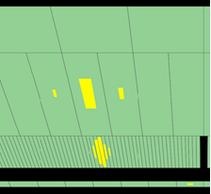
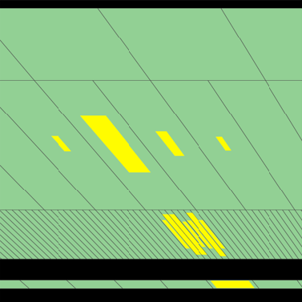
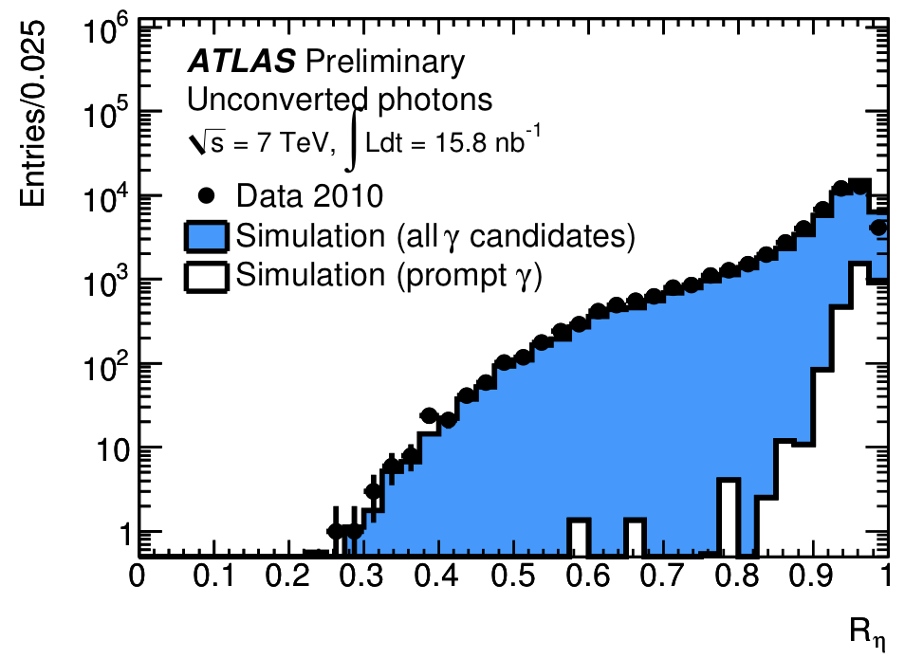
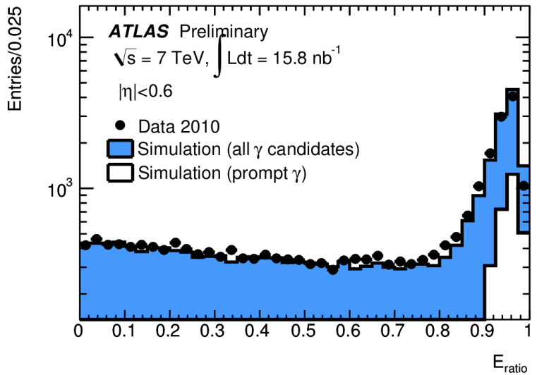
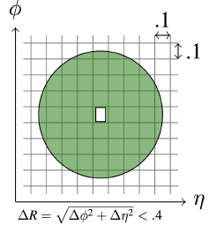
Photon identification
π⁰ candidate
ϒ candidate
loose and tight
selections optimized
separately for
unconverted and
converted γ
M.Delmastro
Isolation: E_{T}iso<3 GeV
γ shower
Examples of discriminating shower shape variables
transverse shape variable
energy deposit in the first longitudinal compartment of the
electromagnetic calorimeter
Surrounding E_{T}

Slide 21
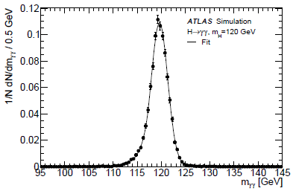
γ energy resolution
E_{γ} and M_{γγ} resolution is estimated with Monte-Carlo.
The core component of the mass resolution ranges from 1.4 GeV in the “Unconverted central” category
to 2.1 GeV in the “Converted transition” category.
Monte-Carlo for H→γγ M_{H} = 120 GeV

Slide 22
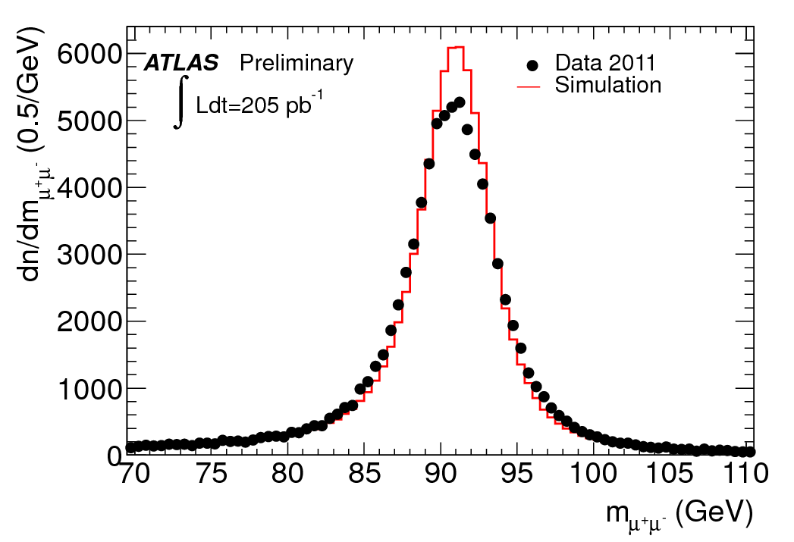
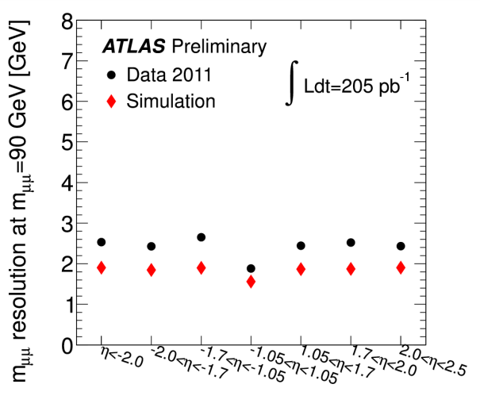
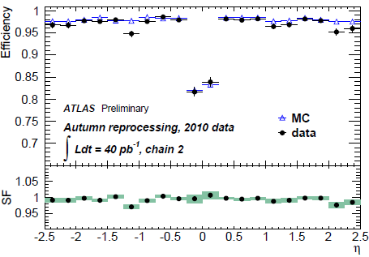
Muon combined
The momentum resolution is extracted from the width of the di-muon mass distribution in Z →μμ decays and the comparison of the independent measurements of muons from Z →μμ and W →μν decays provided by the two ATLAS tracking systems, the Inner Detector and Muon Spectrometer.
The muon reconstruction efficiencies are measured with Z →μ+μ− decays in which one of the decay muons is
reconstructed in both systems and the other is identified by just one of the systems in order to probe the
efficiency of the other.

Slide 23
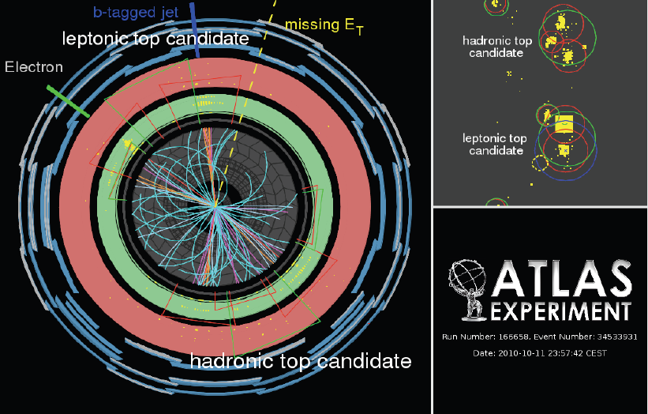
Top
Example of tt̅ event

Slide 24
Results on t-quark
four papers are selected for this report out of long list of new results

Slide 25
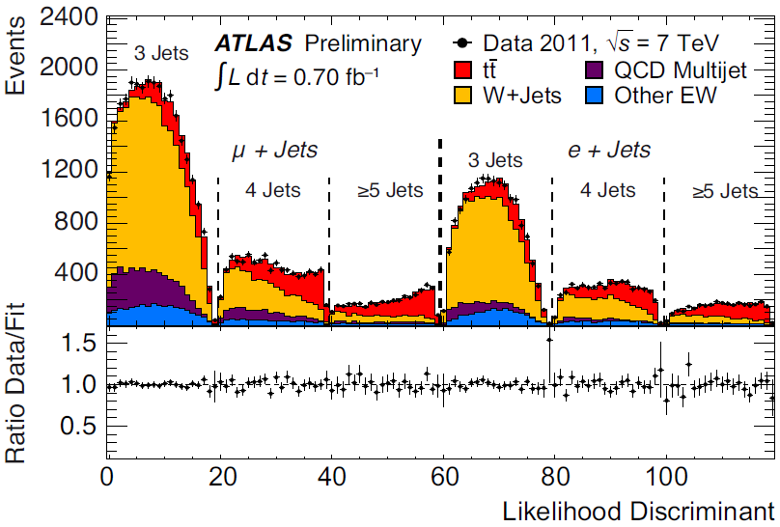
Measurement of the tt̅ production cross-section in pp collisions at √s = 7 TeV using kinematic information of lepton+jets events ATLAS-CONF-2011-121
lepton+jets without b-tagging
→no related systematics
→ worse S/B
Selection: high p_{T} e or μ, at least three jets with p_{T} > 25 GeV and η < 2.5, ET^{miss} > 25 GeV, m_{T} (W) > 25 GeV, m_{T}(W)+E_{T}^{miss} >60 GeV
Likelihood discriminants:
lepton η, leading jet p_{T}, aplanarity, H_{T,3p}
Background processes fitted within constraints.
Floating W+jets background → no uncertainty from W normalization
simultaneous fit in 6 channels
(μ+3j, μ+4j, μ+≥5j, e+3j, e+4j, e+≥5j)
σ tt̅ = 179.0 ±9.8(stat+syst) ±6.6(lumi) pb
Most precise measurement of σ tt̅ (more precise than theoretical predictions - SM: 164.6 pb )

Slide 26
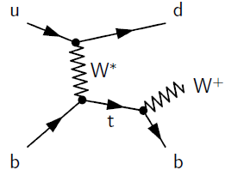
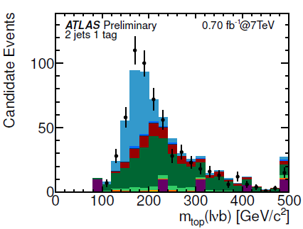
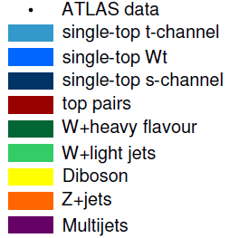
Measurement of the t-channel Single Top-Quark Production Cross Section ATLAS-CONF-2011-101
Selected events contain one electron or muon, missing transverse energy, two or three jets, one of them being identified as coming from a b-quark.
main analysis: cut based
four variables are used:
the invariant mass of the b-tagged jet, the lepton and the reconstructed neutrino
the absolute value of the pseudorapidity of the untagged,
H_{T},
the difference in the pseudorapidity of the b-tagged jet and the untagged jet
Final result: 2 and 3 jets combination
σ_{t} (t-channel) = 90 ± 9(stat) ⁺³¹₋₂₀(syst) pb =
90⁺³²₋₂₂ pb
σ th (SM) = 65 ± 3 pb

Slide 27
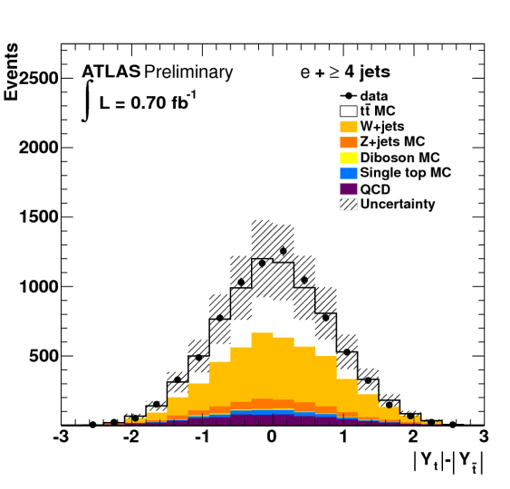
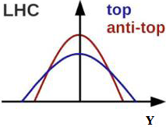
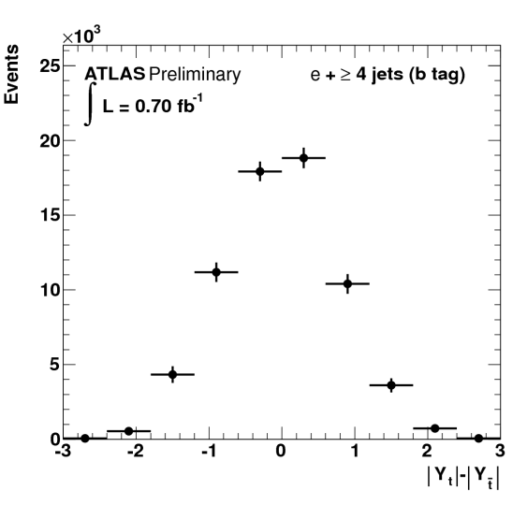
Measurement of the charge asymmetry in top quark pair production ATLAS-CONF-2011-106
Small asymmetry predicted in qq → ttg and qg → ttq.
Exchange of new particles like Z’ or axigluon could modify it.
Measured asymmetry before unfolding and b-tagging
Selected events are required to have a single lepton (electron or muon),large missing transverse energy and at least four jets. A kinematic likelihood is used to
reconstruct the t t̅ event topology
Unfold to t-quark level to compare with theory
A_{C} = -0.024 ± 0.016stat ± 0.023syst
A_{C} SM = 0.006
After unfolding and b-tagging,
statistical uncertainty only

Slide 28
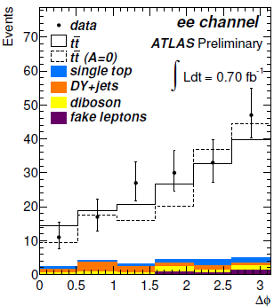
Measurement of spin correlation in tt̅ production from pp collisions at √s=7 TeV ATLAS-CONF-2011-117
Short lifetime → spin info is preserved in decay products.
Spins of t and t̅ are correlated. Major channel gg→tt̅ (in contrast with the tevatron).Spin information can be accessed via angular distributions of decay products
Deviation from QCD prediction → new physics, e.g. t →H+b
Base analysis:
dileptons without b-tagging:
measure Δϕ between leptons in lab frame
fit Δϕ with a sum of SM correlation and no correlation templates
result: f _{SM} = 1.06±0.21
A _{helicity} = 0.34 +0.15－0.11
[A _{helicity} SM NLO=0.32]

Slide 29
Spare slides

Slide 30
ATLAS upgrade
Tentative upgrade schedule

Slide 31
Data analysis
Grid: A distributed computing infrastructure, uniting resources of HEP institutes around the world to provide institutes seamless access to CPU and storage for the LHC experiments
Tier-0 (CERN) : recording –reconstruction –distribution
Tier-1 (~10 centres) : storage -reprocessing –analysis
Tier-2 (~140 centres) : simulation –end-user analysis

Slide 32
σtt dilepton
σtt = 171 ± 6 (stat) +16-14 (syst) ± 8 (lumi) pb
σtt = 177 ± 6 (stat) +17-14 (syst) +8-7 (lumi) pb (w/ b-tag)
σt (Wt-channel) < 39 (41) pb
[σth(SM) = 15.7 ± 1.4 pb]
σt (s-channel) < 26.5 (20.5) pb
[σth(SM) = 4.6 ± 0.3 pb]

Slide 33
Aplanarity:
the smallest eigenvalue of the momentum tensor
H_{T;3p} : the transverse momentum of all but the two leading jets, normalized to the sum of absolute values of all longitudinal momenta in the event
The anti-kt algorithm constructs, for each input object (either energy cluster or particle) i, the quantities dij and
diB as follows:
where
kti is the transverse momentum of object i with respect to the beam direction.
A list containing all the dij and diB values is
compiled. If the smallest entry is a dij, objects i and j are combined (their four-vectors are added) and the list is updated. If the smallest entry is a diB, this object is considered
a complete ‘‘jet’’ and is removed from the list.

