Slide 1
Neutrino Mass due to Quintessence
and
Accelerating Universe
Gennady Y. Chitov Laurentian University, Canada

Slide 2
Collaborators:
Tyler August, Laurentian, Canada
Tina Kahniashvili, Carnegie Mellon, USA
Aravind Natarajan, Carnegie Mellon, USA
References:
1. G.Y. Chitov, T. August, N. Aravind, T. Kahniashvili, PRD (2011)
2. G.Y.C. et al, work in progress
Supported by:

Slide 3
Outline:
Motivation and Introduction
Model and Formalism
Fermion Mass Equation
Three Phases of the Universe (Stable, Metastable,
Unstable)
Key Results for the Parameters of the Model
Dynamics of the Model Scales and Observable
Universe
Conclusions

Slide 4
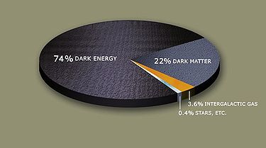
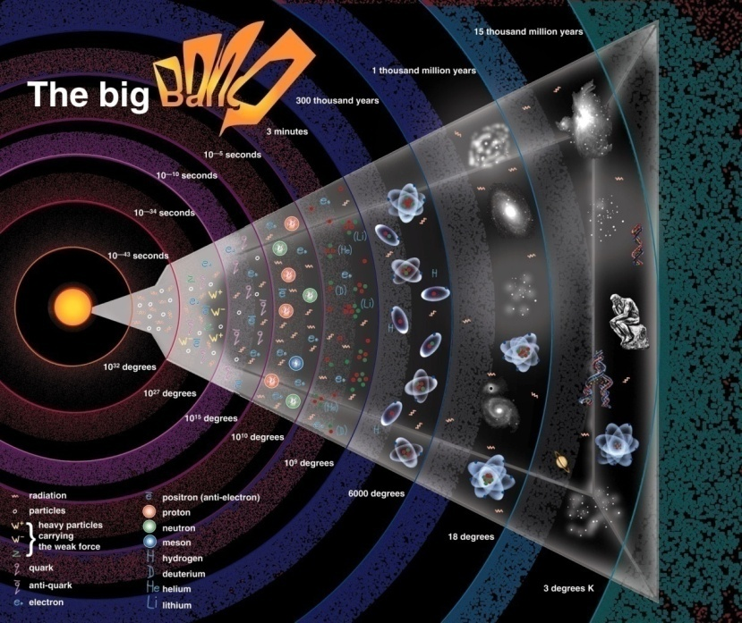
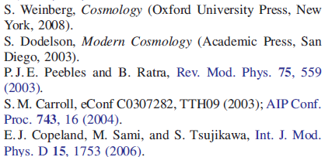
Composition of the Universe: Bookkeeping
Wikipedia
DE <=>
Scalar Field – Quintessence (Fifth Force)
Gravity
E&M
Strong
Weak
???
References:
DE/DM-dominated era

Slide 5
Dark Energy and Cosmological Constant
Einstein (1917)
Dark Energy, Anti-Gravity (“Gravitational Repulsion”)
DE as Cosmological Constant:
(1) “Fine Tuning” Problem
(2) Coincidence Problem

Slide 6
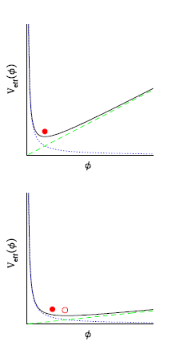
Varying Mass Particles (VAMPS)
Ingredients:
Scalar field (Quintessence) → DE
Massless Particles
Yukawa coupling
VAMPs
Anderson & Carroll, 1997
Hoffmann, 2003
Mass-Varying Neutrino (MaVaN) Scenario
Fardon, Nelson & Weiner (2004)
Trouble (!!!): Instability
Solution (???)

Slide 7
Mass Varying Neutrino Scenario (MaVaN):
We study the case when the quintessence potential U does not have a non-trivial minimum
→ the generation of the fermion mass is due to breaking of the chiral symmetry in the Dirac sector of the Lagrangian.
(2) We assume the cosmological evolution governed by the scalar factor
a(t) to be slow enough:
→ The system is at equilibrium at a given temperature T(a)
→ The methods of the thermal quantum field theory can be applied.
We study possibly the simplest “minimal model”:
→ fermions are described by the Dirac spinor field
→ zero chemical potential

Slide 8
Model and Formalism:
The Euclidian action of the model in the FLRW metric:
The partition function
of the coupled model
The Ratra-Peebles
quintessence potential
Saddle-Point Approximation ←→ Min of the (Grand) Thermodynamic Potential

Slide 9
Mass Equation and Critical Temperatures:
Mass equation:

Slide 10
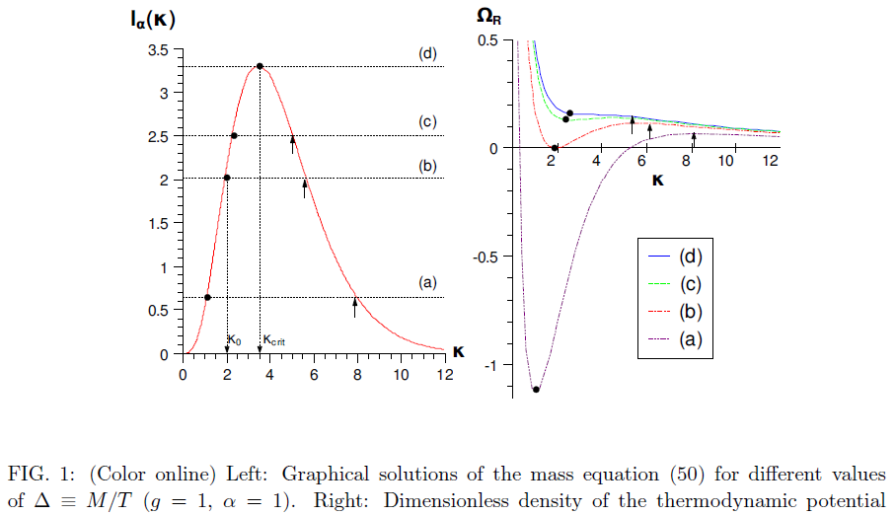
Spinodal Decomposition
There are 3 phases:
(1) Stable (T>>M)
(2) Metastable (T~M)
(3) Unstable (T<M)
via First-Order Phase Transition

Slide 11
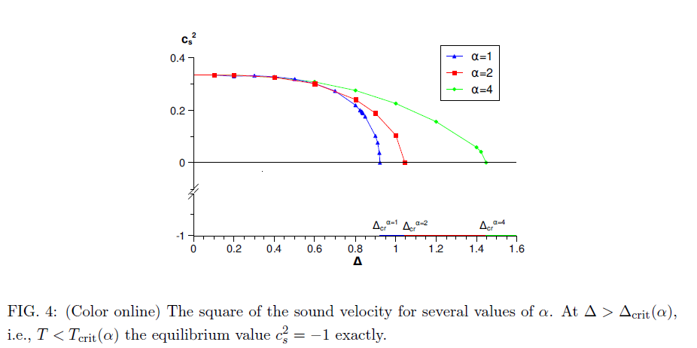
Velocity of Sound & Stability:

Slide 12
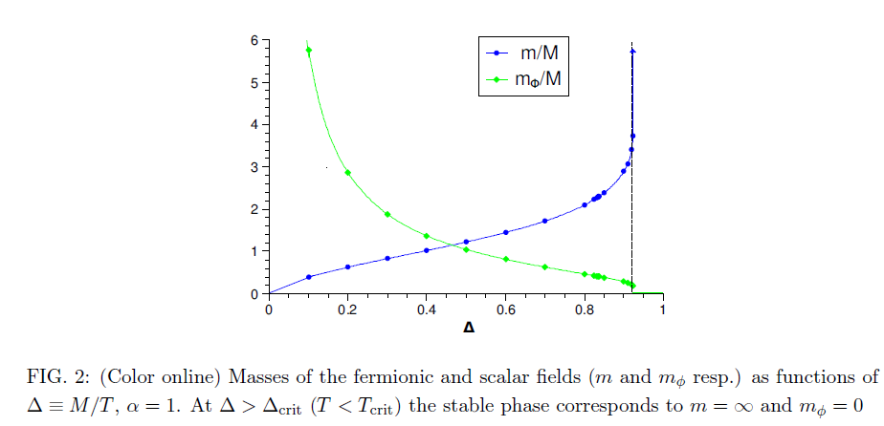
Masses vs. Temperature:

Slide 13
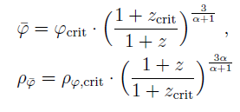
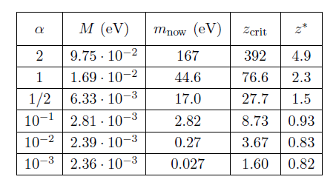
Dynamics of the Model and Observable Universe
●Currently we are below the critical temperature (!!!)
The equation of motion:
Matter-dominated & Slow-rolling regimes:
Single scale M (!!)

Slide 14
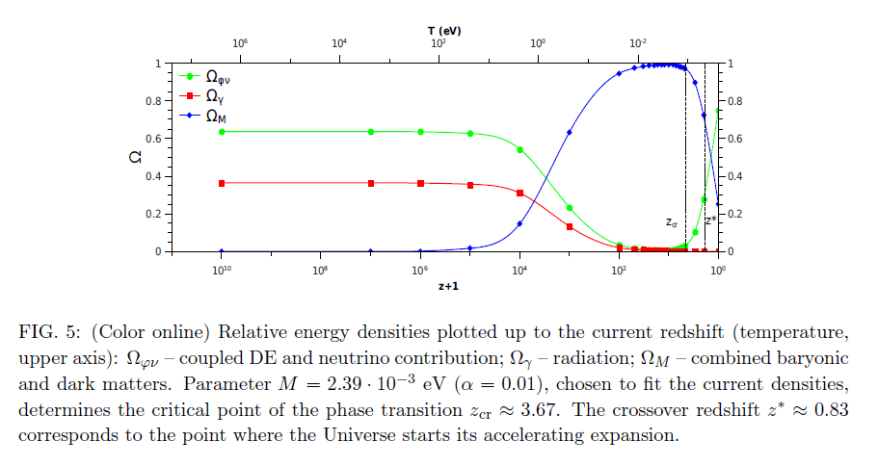

Slide 15
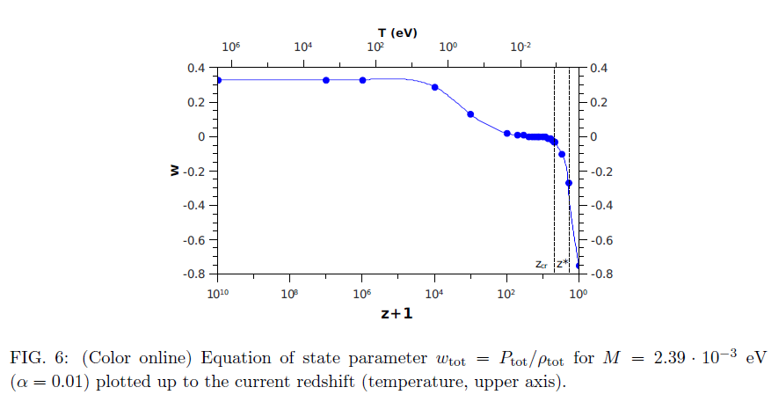
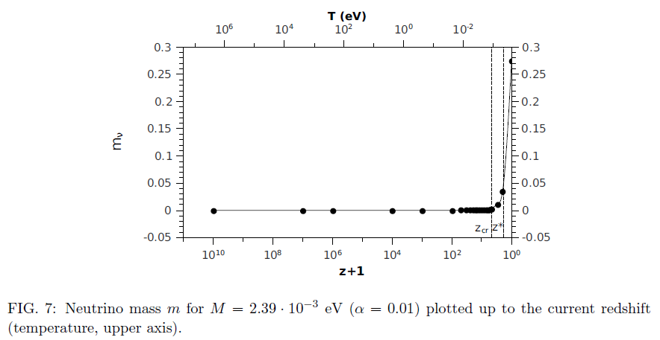

Slide 16
Conclusions:
Model: DE-DM + Ratra-Peebles quintessence potential
Following the time arrow, the stable, metastable and unstable phases are predicted.
The present Universe is below its critical temperature.
The first-order phase transition occurs:
metastable oscillatory →unstable (slow) rolling regime at
By choosing M to match the present DE density
→ present neutrino mass
+ redshift where the Universe starts to accelerate
5. Further work (in progress): Toy model → Real model
→ Extension of the standard model

Slide 17
THANK YOU !

